Slide 1
NodeJS Internals and Architecture
husseinnasser
Understand the inner working of Node to build efficient apps

Slide 2
Introduction
husseinnasser

Slide 3
Introduction
husseinnasser
Welcome
Who this course is for?
Course Outline

Slide 4
Node Architecture
husseinnasser
Understanding Node Execution

Slide 5
Interrupted Language and role of V8
husseinnasser
Interpreted vs Compiled Languages

Slide 6




Machine Code
Programs run on machine code
Specific to the CPU
Each CPU has different instructions set
RISC vs CISC

Slide 7
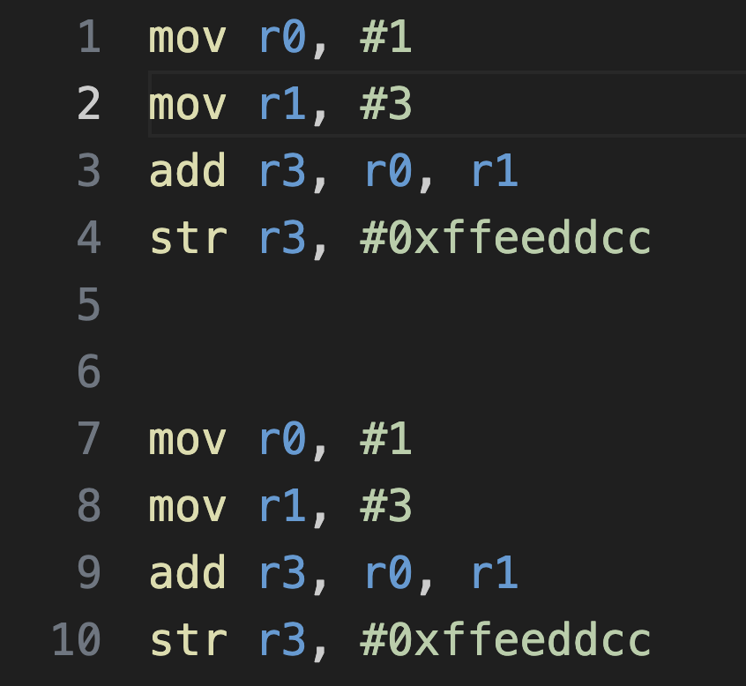
Assembly
Closest to the machine code
Still sometimes CPU specific
Easier to write
Not easy enough though

Slide 8
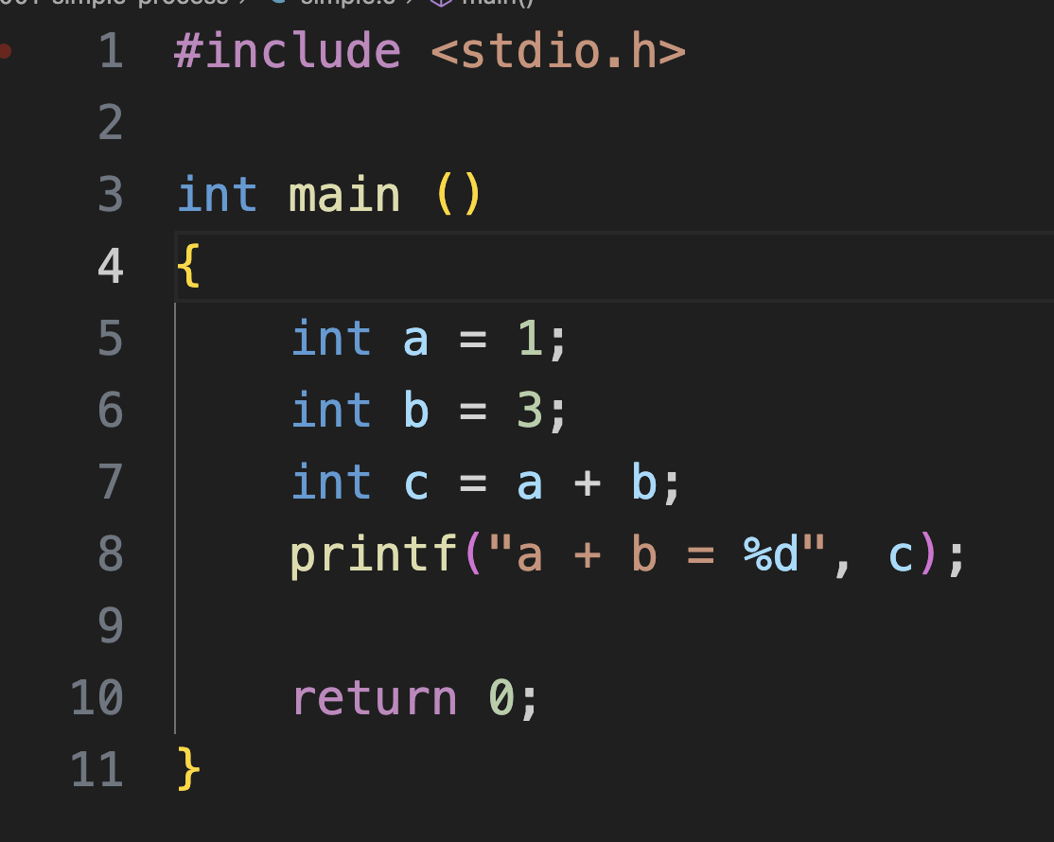
High level languages
HLL are more convenient
Abstractions to hide complexity*
Need to compile for a CPU
Compile turns code to machine code
Linking creates executable file
*That is good and bad

Slide 9
Compiling
Compile produces machine code in form of object files
Each object file may present a source file
Object files are not ready to be run
They need to be linked and create an executable
E.g. gcc, clang, rustc
Source
compile
Binary, sets of instructions

Slide 10
Linking
Linkers creates an executable file
Finds and links all object files required and create one file
The file is an “executable”
Executable files have types
E.g. ld,gold linker,lld, mold
Binary Object 1
Executable
Headers
link
Binary Object 1
Binary Object 2
Binary Object 2

Slide 11
Interpreted Languages
A compiled program doesn’t work everywhere
Must match the CPU/OS
Can I write my code once and run it everywhere?
Interrupted languages
Python/Javascript/Java
These are just “input” to a program
hello.py
index.js
program.jar
python
node
java

Slide 12
Interpreted Languages
Must have a runtime, node.exe
Node.exe is a compiled program for every OS/CPU
Your code index.js runs everywhere
Windows node.exe index.js
Linux ./node index.js
Same for Python

Slide 13
Interpreted Languages
The trick is each line interrupted
If you see “+” do “this”, if you see “-” do “this”
Slower
Byte code (not string code)
The Job of V8 engine in Node

Slide 14
Just in Time Compilation (JIT)
I’m interpreting this code a lot
Let me compile it directly to machine code
Put it on the heap
Mark memory as executable
Point the CPU program counter to it

Slide 15
Garbage Collection
Memory management is tricky
Some languages manages it for you
Go, Python, Java
Some languages you have to do it
C, C++
Some implement it as part of code
Node (v8)
Garbage collection is part of the runtime
Tags every object and tracks it
Can cause slow downs
Notes:
Read more about v8 GC https://v8.dev/blog/high-performance-cpp-gc

Slide 16
V8 Engine
Just in Time Compilation
JavaScript -> Bytecode (faster)
Mark and Sweep Garbage collection
Efficient heap memory management
Remember JavaScript is dynamically typed
We don’t know how large objects
Inline caching
Notes:
Javascript is a dynamic typed language, ie, we do know the size.. It can change. So the objects can be anywhere

Slide 17
V8 Engine
V8 stores primitive data type in the stack
let x = 5;
Objects and Arrays are stored in the heap
Both are treated as objects
The Object has two arrays:
Named properties
{"x": 90} → [90]
{"a": 10,"b": 20,0: 30} → [10,20]
Elements (index based)
[8,9,10] → [8,9,10]
{"a": 10,"b": 20,0: 30} → [30]
8 byte size
Properties “keys” themselves are stored in a hidden class
y object
properties
elements

Slide 18
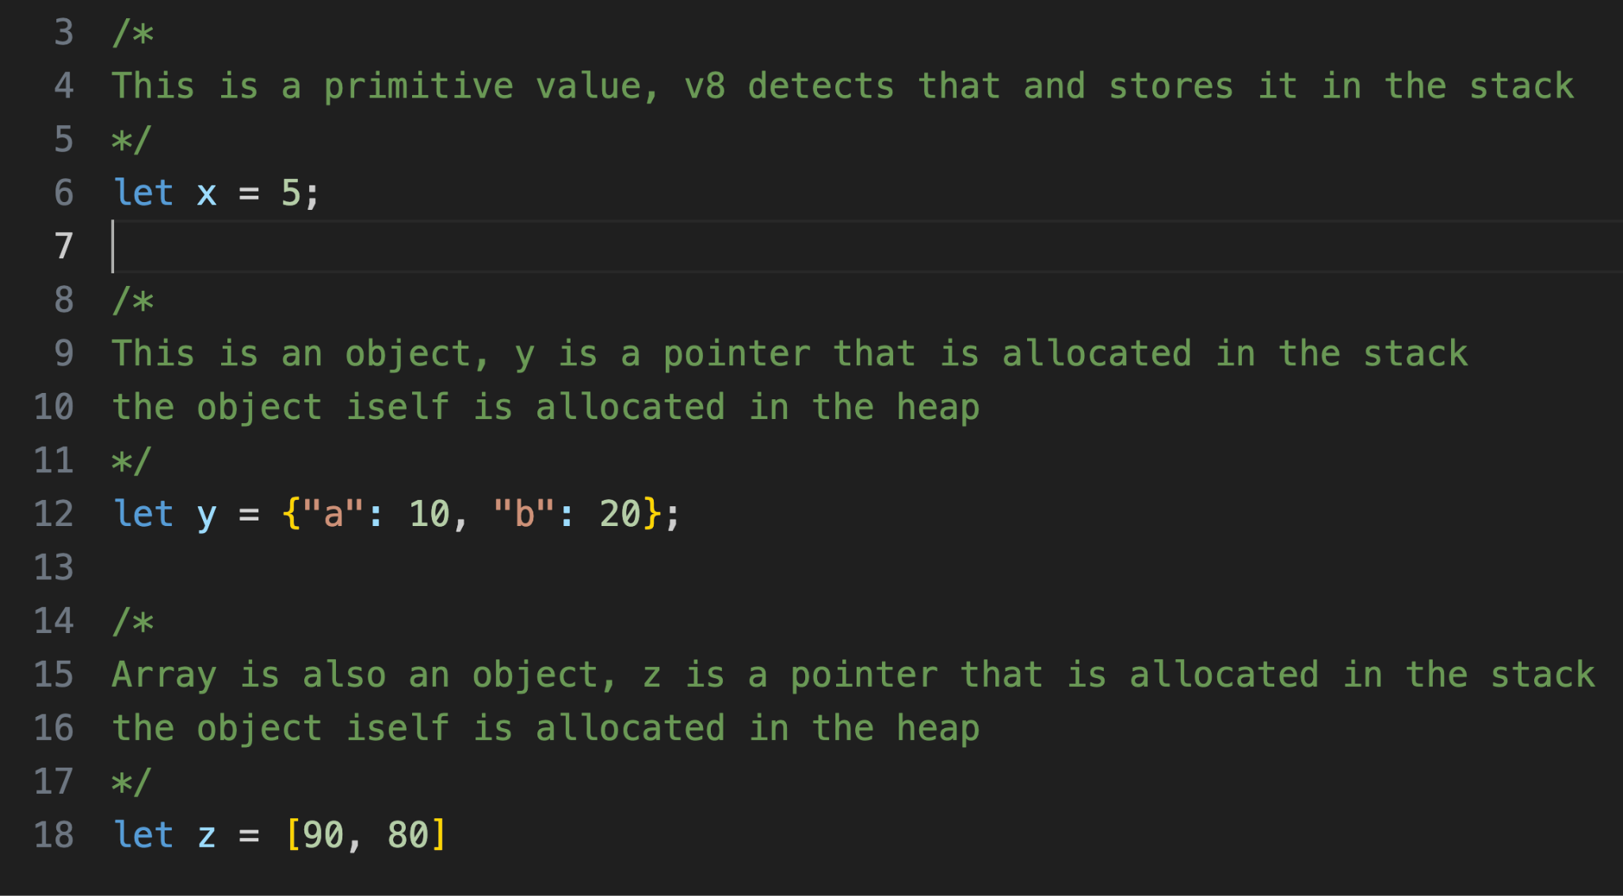
V8 Engine Object
double x = 5
y* = 0x555555
Stack
0x555555
y object
properties
elements
y properties array
10
20
Heap
x is stored in stack as 5
y pointer stored in the stack
y js object stored in the heap
Property values stored separately as an array
Property names stored separately as an array
Hidden class / descriptors
Properties array points to the properties array
y hidden class/
property descriptors
‘a’
‘b’
Node V8 code
Notes:
https://v8.dev/blog/fast-properties

Slide 19
V8 Engine Arrays
z* = 0x444444
Stack
0x444444
z object
properties
elements
z pointer stored in the stack
z js object stored in the heap
Array is just elements (index based)
Elements pointer to the elements
Heap
z elements array
90
80
Node V8 code
Notes:
https://v8.dev/blog/fast-properties

Slide 20
V8 Engine inline caching
double x = 5
y* = 0x555555
Stack
0x555555
y object
properties
elements
a’s offset 0 (inline cache)
y.a is accessed
V8 needs to know the offset of a in the properties array
V8 looks up hidden class property descriptor array
Finds ‘a’ in offset 0
Uses 0 to access the properties array gets 10!
This is slow…
So v8 remember this and cache it in the object
y properties array
Heap
10
20
y hidden class/
property descriptors
‘a’
‘b’
Node V8 code
Notes:
https://v8.dev/blog/fast-properties

Slide 21
Summary
Compiling vs Linking
Compiled Languages
Interrupted Languages
Garbage collection
V8

Slide 22
The Event Loop
husseinnasser
Node’s loop

Slide 23
Node Execution
Node is a C++ program that takes input
The first input is a JavaScript file
Node reads the file and interpret the JavaScript
JS Code is executed line by line serially until it is done

Slide 24
How about these situations?
Timers
Execute this code after X ms
File I/O
Read this file and execute this code when done
Network I/O
Listen on a port and execute this code when a connection is accepted
Connect to a server and check for incoming data on a connection
Serial execution doesn’t work

Slide 25
Meet the Event Loop
Single Thread*
Asynchronous Non-blocking I/O
A loop with phases
Each phase has queue of callbacks
Terminates when there is no callbacks left

Slide 26

Event Loop (Simplified)
Initial code execution
Optionally register callback
Execute callback
Callback may register more callbacks
Run until the queues are empty

Slide 27
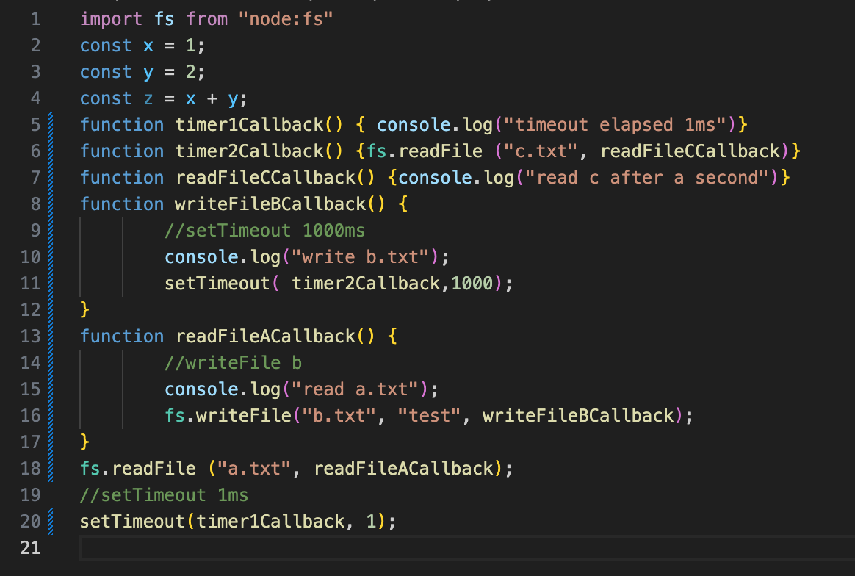
Execute initial code
Execution
x=1
y=2
z = x + y
Callbacks
Notes:
import fs from "node:fs"
const x = 1;
const y = 2;
const z = x + y;
fs.readFile ("a.txt",
//readFile a
() =>
{
//writeFile b
fs.writeFile("b.txt", "test", () => {
//setTimeout 1000ms
setTimeout( ()=> fs.readFile ("c.txt",
//read file c
() => console.log("read c after a second") ), 1000);
})
}
);
//setTimeout 1ms
setTimeout( () => console.log("timeout elapsed 1ms"), 1);

Slide 28
Register readFile A callback
Execution
Callbacks
readFileACallback
Notes:
import fs from "node:fs"
const x = 1;
const y = 2;
const z = x + y;
fs.readFile ("a.txt",
//readFile a
() =>
{
//writeFile b
fs.writeFile("b.txt", "test", () => {
//setTimeout 1000ms
setTimeout( ()=> fs.readFile ("c.txt",
//read file c
() => console.log("read c after a second") ), 1000);
})
}
);
//setTimeout 1ms
setTimeout( () => console.log("timeout elapsed 1ms"), 1);

Slide 29
Register setTimeout 1ms timer1Callback
Execution
Callbacks
readFileACallback
timer1Callback
Notes:
import fs from "node:fs"
const x = 1;
const y = 2;
const z = x + y;
fs.readFile ("a.txt",
//readFile a
() =>
{
//writeFile b
fs.writeFile("b.txt", "test", () => {
//setTimeout 1000ms
setTimeout( ()=> fs.readFile ("c.txt",
//read file c
() => console.log("read c after a second") ), 1000);
})
}
);
//setTimeout 1ms
setTimeout( () => console.log("timeout elapsed 1ms"), 1);

Slide 30
Pop readFileACallback callback
Execution
readFileACallback
Callbacks
readFileACallback
timer1Callback
Notes:
import fs from "node:fs"
const x = 1;
const y = 2;
const z = x + y;
fs.readFile ("a.txt",
//readFile a
() =>
{
//writeFile b
fs.writeFile("b.txt", "test", () => {
//setTimeout 1000ms
setTimeout( ()=> fs.readFile ("c.txt",
//read file c
() => console.log("read c after a second") ), 1000);
})
}
);
//setTimeout 1ms
setTimeout( () => console.log("timeout elapsed 1ms"), 1);

Slide 31
Register writeFile b callback
Execution
readFileACallback
console.log
Callbacks
readFileACallback
timer1Callback
writeFileBCallback
Notes:
import fs from "node:fs"
const x = 1;
const y = 2;
const z = x + y;
fs.readFile ("a.txt",
//readFile a
() =>
{
//writeFile b
fs.writeFile("b.txt", "test", () => {
//setTimeout 1000ms
setTimeout( ()=> fs.readFile ("c.txt",
//read file c
() => console.log("read c after a second") ), 1000);
})
}
);
//setTimeout 1ms
setTimeout( () => console.log("timeout elapsed 1ms"), 1);

Slide 32
ReadFileACallback done, pop timer1CB
Execution
timer1Callback
console.log
Callbacks
timer1Callback
writeFileBCallback
Notes:
import fs from "node:fs"
const x = 1;
const y = 2;
const z = x + y;
fs.readFile ("a.txt",
//readFile a
() =>
{
//writeFile b
fs.writeFile("b.txt", "test", () => {
//setTimeout 1000ms
setTimeout( ()=> fs.readFile ("c.txt",
//read file c
() => console.log("read c after a second") ), 1000);
})
}
);
//setTimeout 1ms
setTimeout( () => console.log("timeout elapsed 1ms"), 1);

Slide 33
Pop writeFile b.txt callback
Execution
writeFileBCallback
console.log
Callbacks
writeFileBCallback
Notes:
import fs from "node:fs"
const x = 1;
const y = 2;
const z = x + y;
fs.readFile ("a.txt",
//readFile a
() =>
{
//writeFile b
fs.writeFile("b.txt", "test", () => {
//setTimeout 1000ms
setTimeout( ()=> fs.readFile ("c.txt",
//read file c
() => console.log("read c after a second") ), 1000);
})
}
);
//setTimeout 1ms
setTimeout( () => console.log("timeout elapsed 1ms"), 1);

Slide 34
Register timer2Callback
Execution
writeFileBCallback
Callbacks
writeFileBCallback
timer2Callback
Notes:
import fs from "node:fs"
const x = 1;
const y = 2;
const z = x + y;
fs.readFile ("a.txt",
//readFile a
() =>
{
//writeFile b
fs.writeFile("b.txt", "test", () => {
//setTimeout 1000ms
setTimeout( ()=> fs.readFile ("c.txt",
//read file c
() => console.log("read c after a second") ), 1000);
})
}
);
//setTimeout 1ms
setTimeout( () => console.log("timeout elapsed 1ms"), 1);

Slide 35
writeFile b done, popup Timeout 1s callback
Execution
timer2Callback
Callbacks
timer2Callback
Notes:
import fs from "node:fs"
const x = 1;
const y = 2;
const z = x + y;
fs.readFile ("a.txt",
//readFile a
() =>
{
//writeFile b
fs.writeFile("b.txt", "test", () => {
//setTimeout 1000ms
setTimeout( ()=> fs.readFile ("c.txt",
//read file c
() => console.log("read c after a second") ), 1000);
})
}
);
//setTimeout 1ms
setTimeout( () => console.log("timeout elapsed 1ms"), 1);

Slide 36
1s elapsed, register readFile c.txt CB
Execution
timer2Callback
Callbacks
timer2Callback
readFileCCallback
Notes:
import fs from "node:fs"
const x = 1;
const y = 2;
const z = x + y;
fs.readFile ("a.txt",
//readFile a
() =>
{
//writeFile b
fs.writeFile("b.txt", "test", () => {
//setTimeout 1000ms
setTimeout( ()=> fs.readFile ("c.txt",
//read file c
() => console.log("read c after a second") ), 1000);
})
}
);
//setTimeout 1ms
setTimeout( () => console.log("timeout elapsed 1ms"), 1);

Slide 37
pop readFile c.txt
Execution
readFileCCallback
console.log
Callbacks
readFileCCallback
Notes:
import fs from "node:fs"
const x = 1;
const y = 2;
const z = x + y;
fs.readFile ("a.txt",
//readFile a
() =>
{
//writeFile b
fs.writeFile("b.txt", "test", () => {
//setTimeout 1000ms
setTimeout( ()=> fs.readFile ("c.txt",
//read file c
() => console.log("read c after a second") ), 1000);
})
}
);
//setTimeout 1ms
setTimeout( () => console.log("timeout elapsed 1ms"), 1);

Slide 38
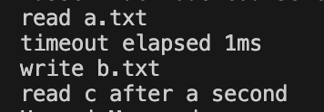
Done. Queues empty, Node exit
Execution
Callbacks
Notes:
import fs from "node:fs"
const x = 1;
const y = 2;
const z = x + y;
fs.readFile ("a.txt",
//readFile a
() =>
{
//writeFile b
console.log("read a.txt");
fs.writeFile("b.txt", "test", () => {
//setTimeout 1000ms
console.log("write b.txt");
setTimeout( ()=> {
fs.readFile ("c.txt",
//read file c
() => console.log("read c after a second")
);
},1000);
});
});
//setTimeout 1ms
setTimeout( () => console.log("timeout elapsed 1ms"), 1);

Slide 39
Summary & demo
Node is a program takes input
The first input is a JavaScript file
Node reads the file and execute the JavaScript
After the execution Node starts a loop
Execution can register callbacks
Callbacks can register more callbacks
Code exercise →

Slide 40
The Main Module
husseinnasser
The Initial phase

Slide 41
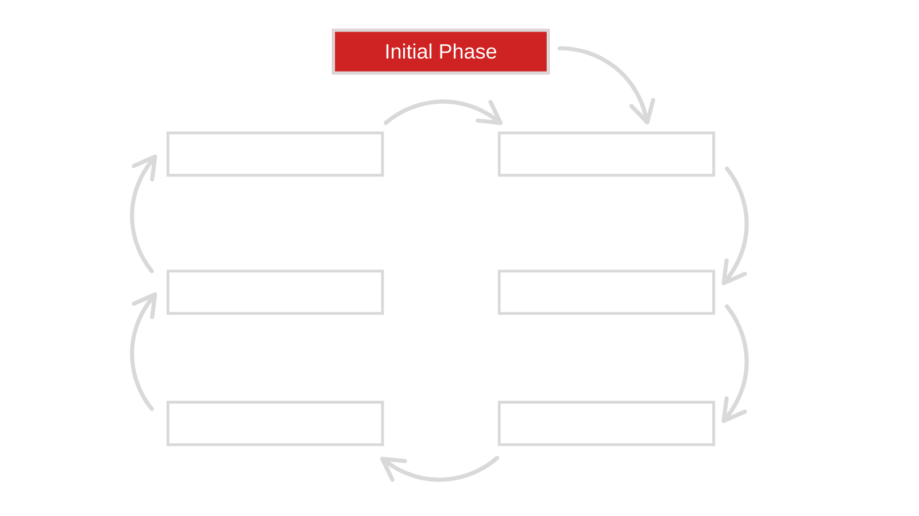

Slide 42
Main Module
All main code execute synchronously
No callbacks can get executed
Main loop not yet initialized
Also called initial phase
Runs once!

Slide 43
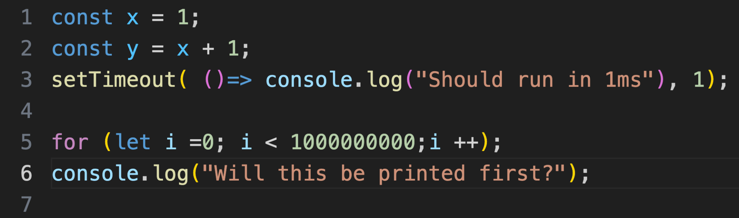
What is the output?

Slide 44
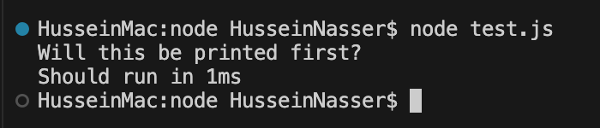
What is the output?

Slide 45
Modules Loads before main module
Modules are resolved first
Code executed first
All require/import modules are loaded
Before running any of the main module
Modules loading other modules

Slide 46
Keep initial phase short!
This is executes first
Keeping it short is great for performance
Spins up node faster
Know your modules

Slide 47
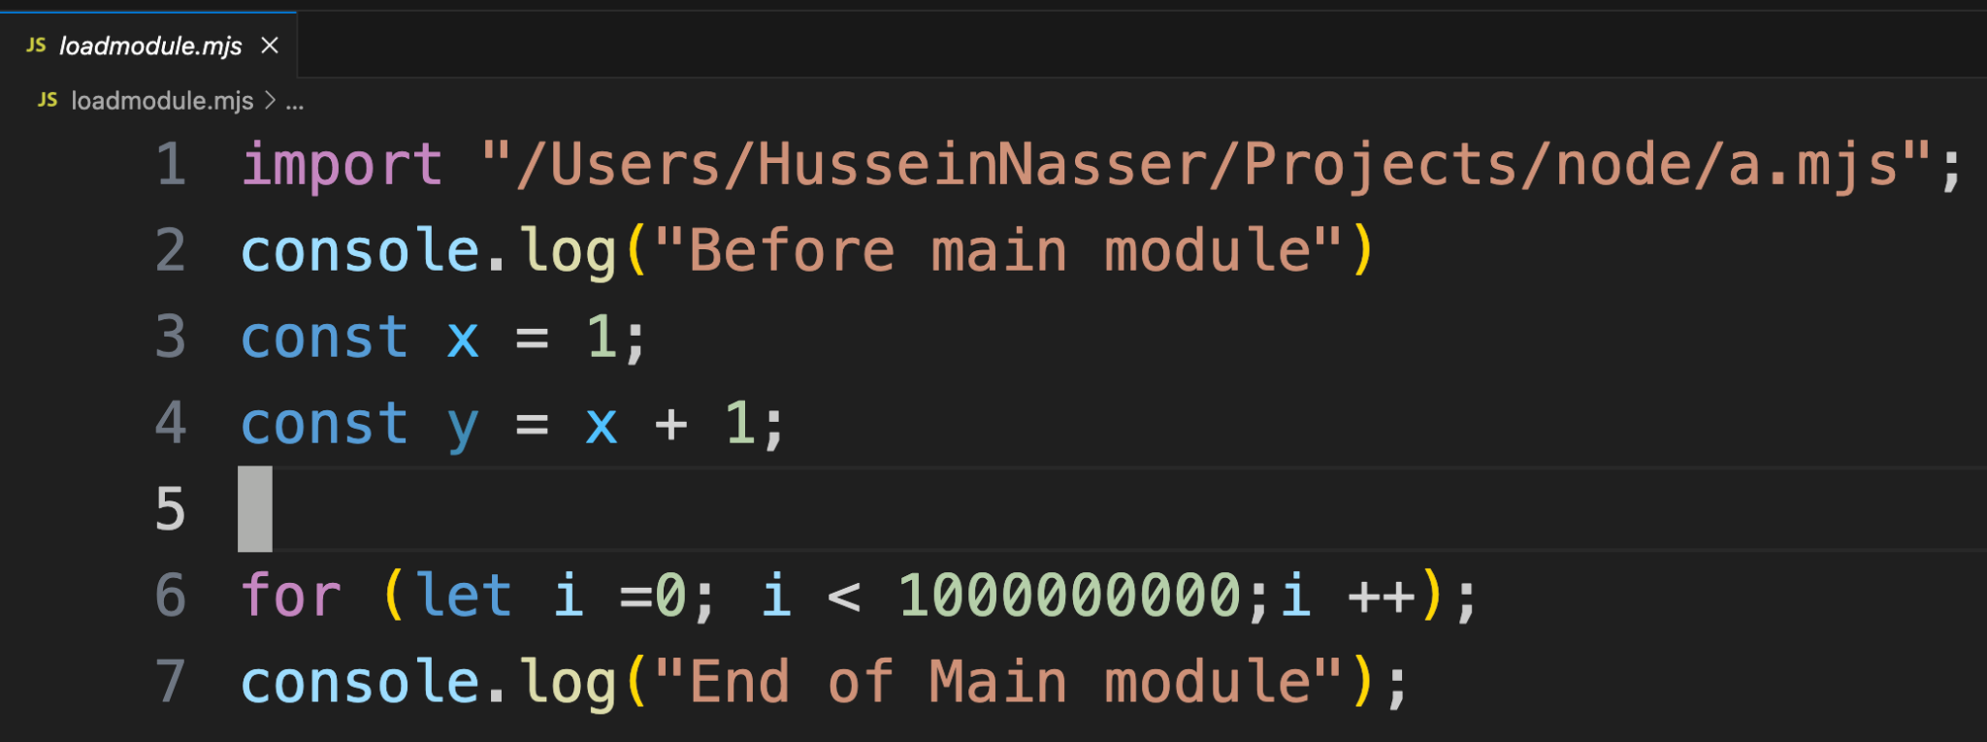
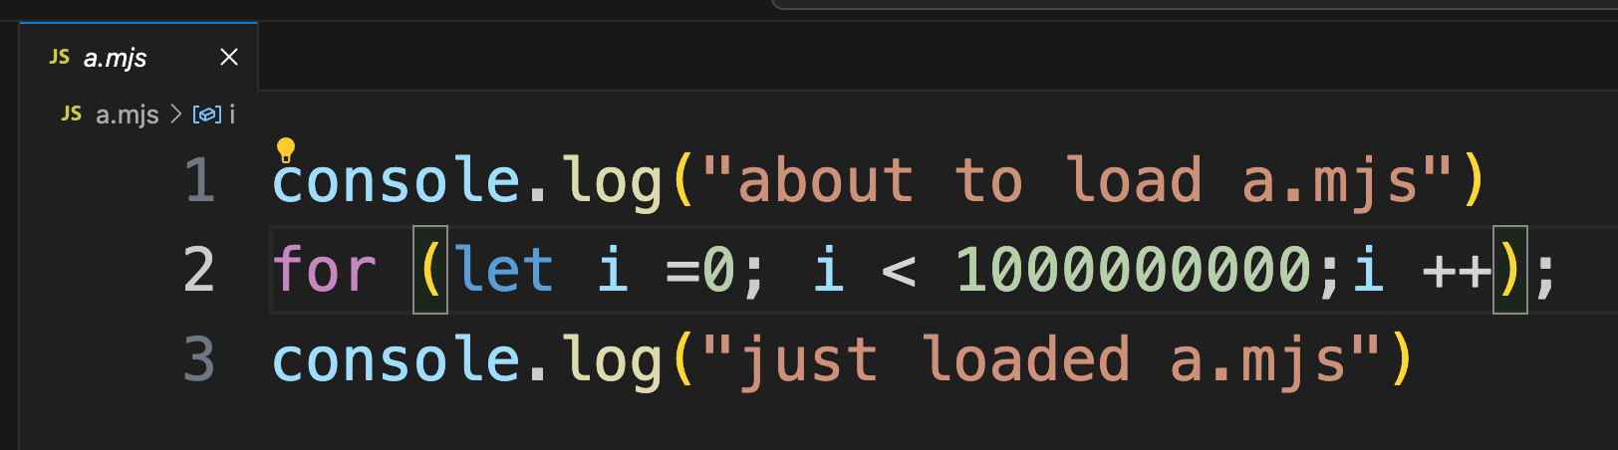
What is the output?

Slide 48
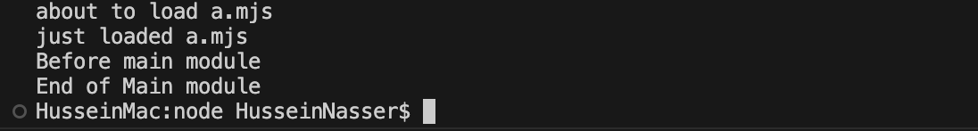
What is the output?

Slide 49
Keep initial phase short!
Because this executes first, keeping it short is great for performance
Spins up node faster
Know your modules

Slide 50
Summary & Demo
Initial phase executes all code synchronously
Modules are loaded first
Once all modules are loaded and executed the main executes
Only then the main loop gets initialized
Code exercise →

Slide 51
The Timer Phase
husseinnasser
Where timers get executed

Slide 52
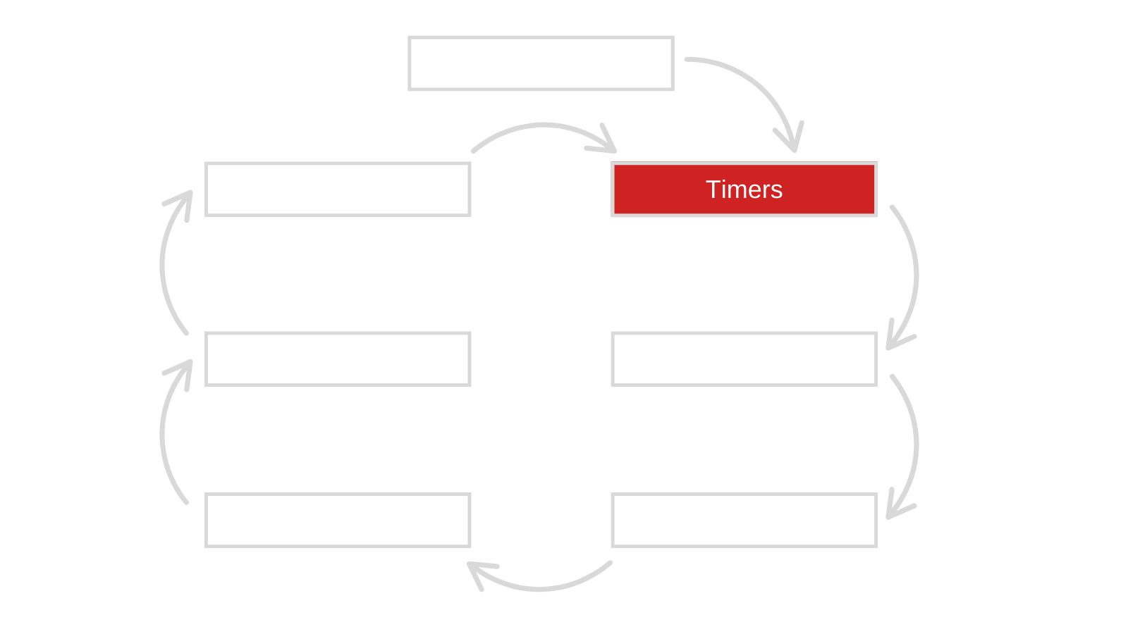

Slide 53
Timers
After initial phase
Event main loop gets initialized
first phase in the loop is timers
Done by the underlying library (libuv)
Timer callbacks get scheduled, sorted by duration
Not accurate
Can be slowed down by other phases

Slide 54
Timer implementation
E.g. 3 timers get scheduled at T0, for 100, 500 and 950 ms
Timers persist the end time
Ask the OS to sleep on libuv thread for smallest (100 ms)
Main loop keeps running normally
OS wakes up the thread after 100 ms and marks the timer as “ready”
Main thread enters timer phase, picks up the ready callbacks and execute
OS sleeps again for the smallest remaining timer (500-T100) (400ms)
Elapsed time
T100ms
T100ms
400ms later
450ms later
100ms later
T500ms
T100-T0
T500ms
T500-T100
T500ms
T950-T500
T950ms
T950ms
T950ms
T950ms
T0
T100
T500
T950

Slide 55
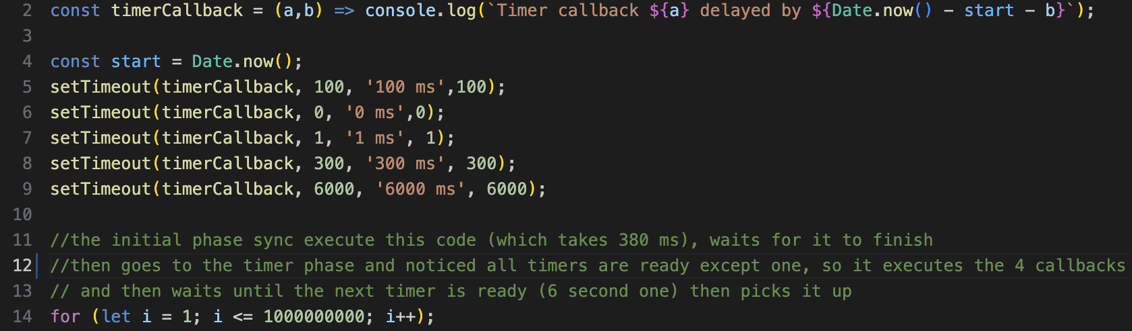
What is the output?

Slide 56
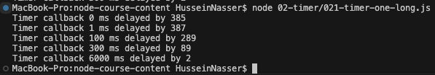
What is the output?

Slide 57
Summary & Demo
Runs after the initial phase
Done by the underlying library (libuv)
Timer callbacks get scheduled, sorted by duration
Other phases can slow it down
Code exercise →
Timers

Slide 58
Pending callbacks
husseinnasser
Delayed callbacks (TCP errors)

Slide 59
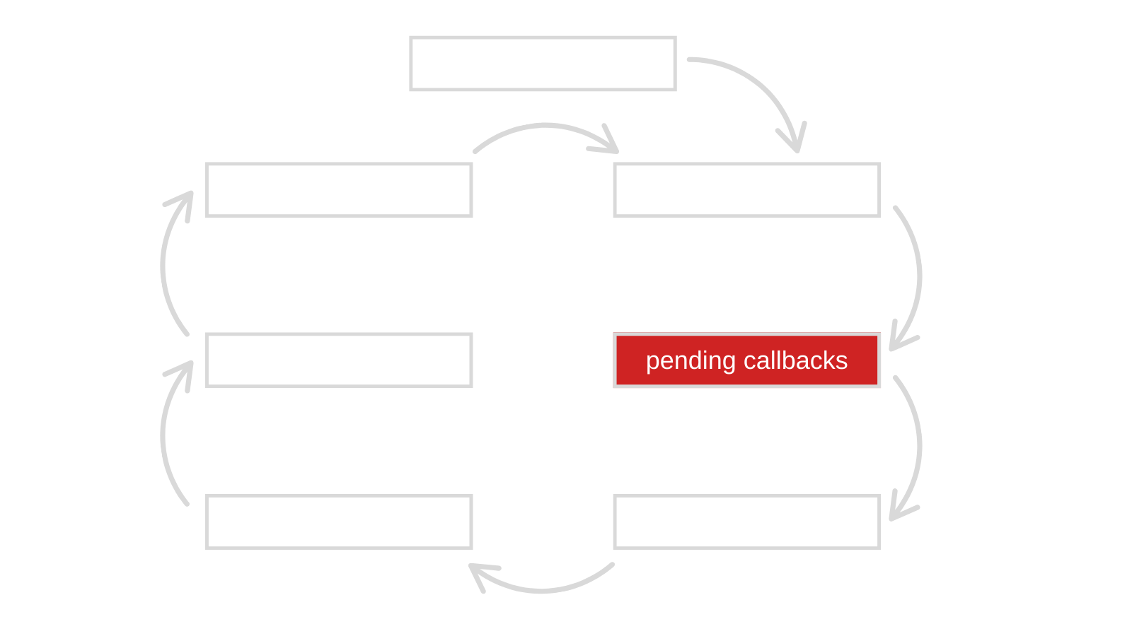

Slide 60
Pending callbacks
Phase for callbacks with low priority
Make room for more important callbacks
Example are tcp errors, and network delays
Deferring it so try later may fix it, avoid unnecessary retries
Not always though

Slide 61
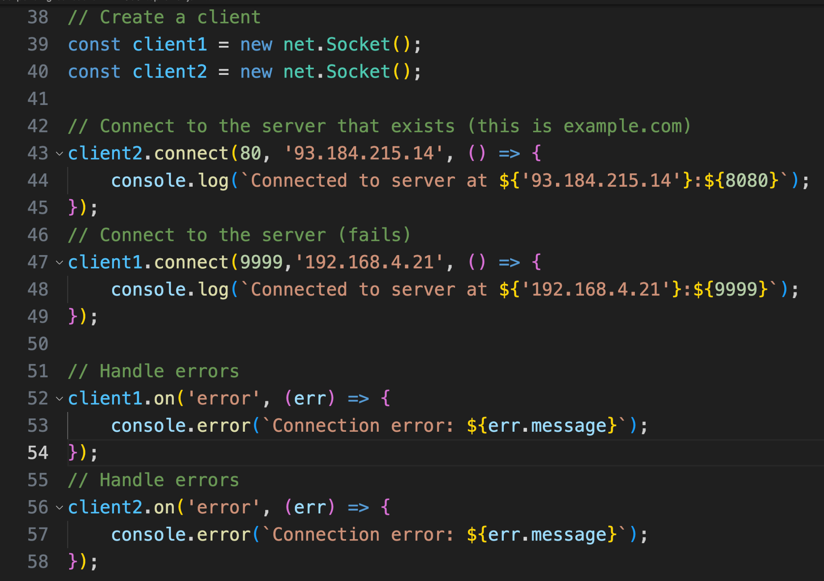
Example
Port 80 is open, this succeeds, callback added to poll phase
Port 9999 isn’t open so this failed, error event is raised
This callback will be scheduled in pending callbacks

Slide 62
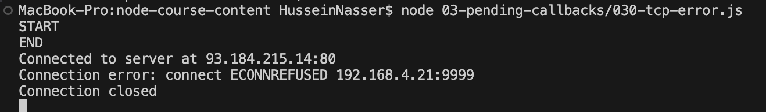
Example

Slide 63
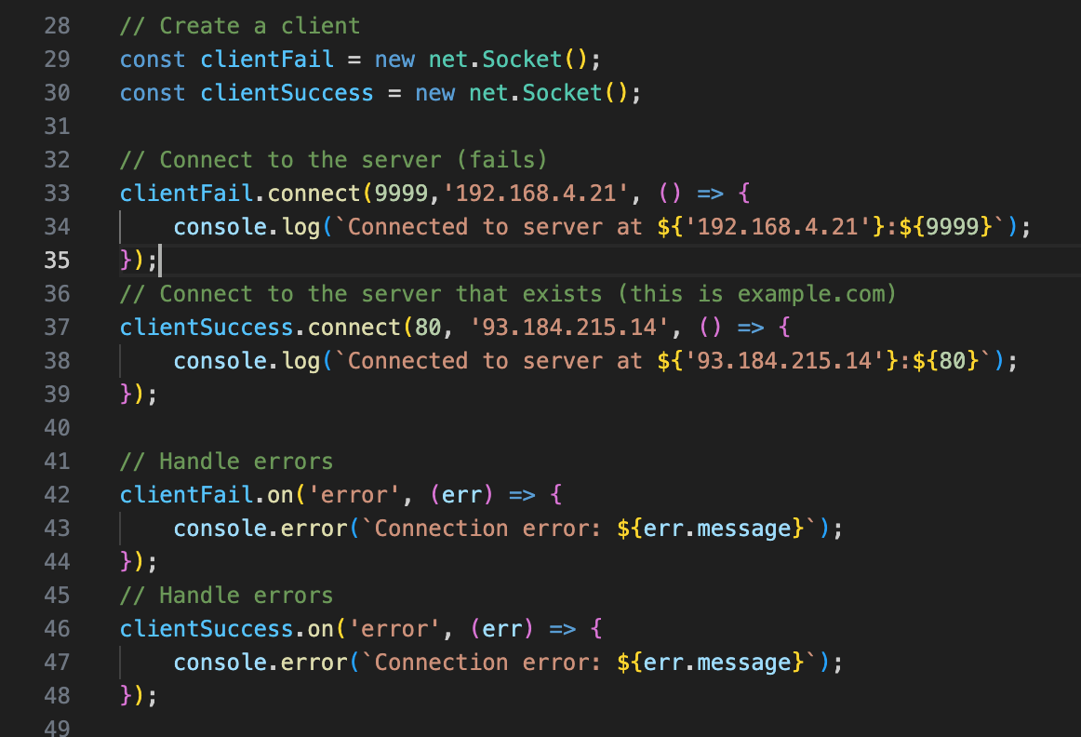
Switch connect order, same output
Port 9999 isn’t open so this failed
Port 80 is open this succeeds, callback added to poll phase

Slide 64
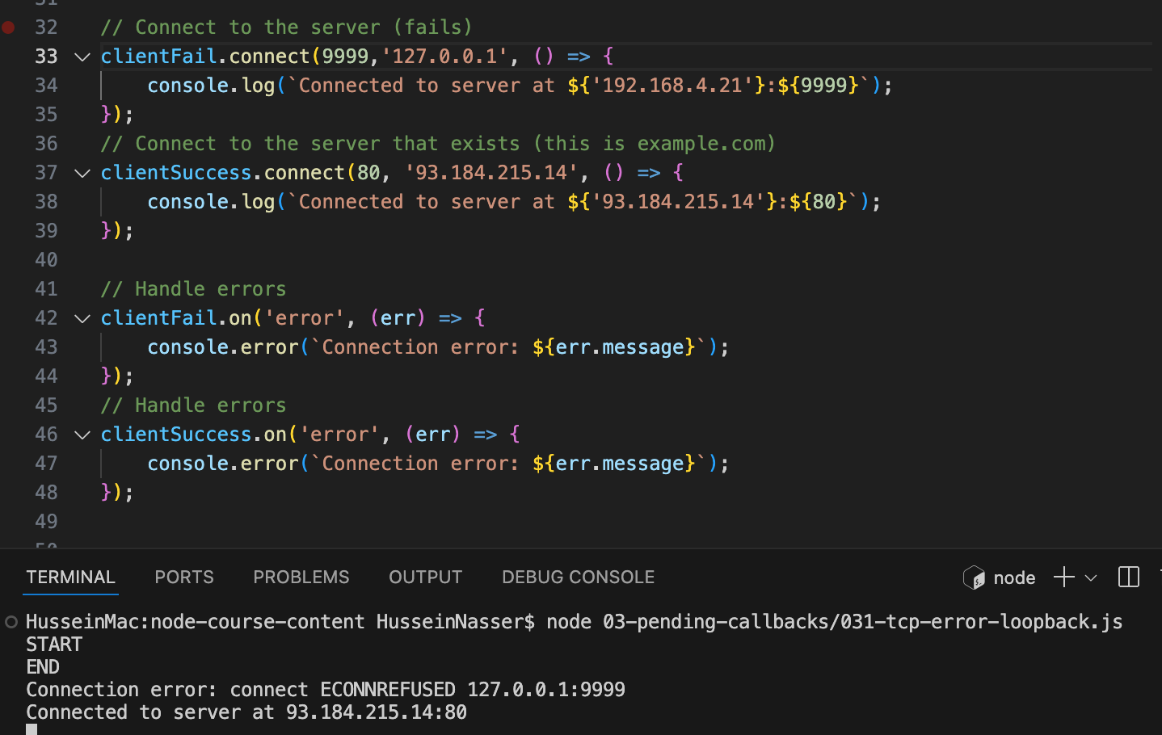
Not always!
Node makes exceptions
Loopback gets priority as per my testing

Slide 65
Summary & Demo
Pending callbacks host TCP errors
Callbacks from TCP errors are scheduled in this phase
The next loop iteration will pick them and execute them
Users can add retry logic
Code exercise →
TCP errors

Slide 66
Idle, prepare
husseinnasser
Internal for node

Slide 67
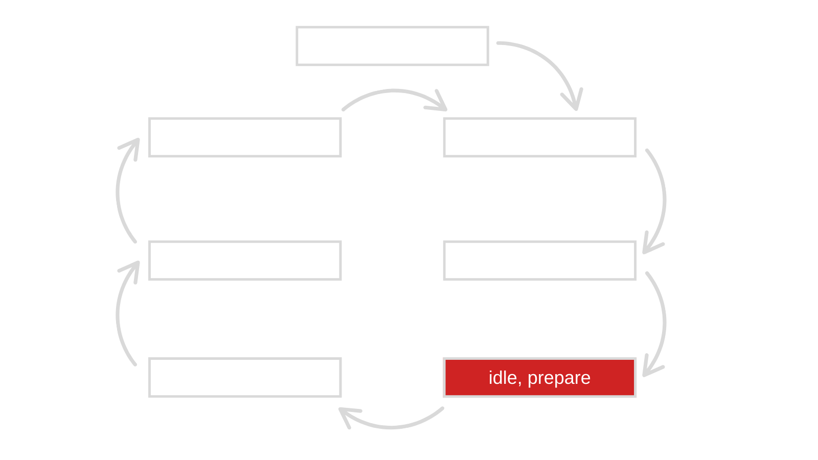

Slide 68
Idle, prepare
Two steps in one phase, used by lib_uv
Node js map this phase to the lib_uv
prepare, idle is not exposed to modules
Can be overridden with C++ Node extensions

Slide 69
Idle
Idle executes every iteration
It still runs in every iteration
Internal tasks

Slide 70
prepare
Prepare executes every iteration before poll
Used to initialize internal structures to prepare for io
E.g. as we receive new connections we want to add it to epoll instance
epoll_ctl(9, EPOLL_CTL_ADD, 10 )
epoll_ctl(13, EPOLL_CTL_DEL, 21)
Follows a wait

Slide 71
Summary & Demo
Idle, prepare runs in every iteration
Not exposed by default
Can be overridden with C++ extensions,
Added here for completion
Code exercise →
Show the prepare phase (server setups)

Slide 72
poll
husseinnasser
Most important phase

Slide 73
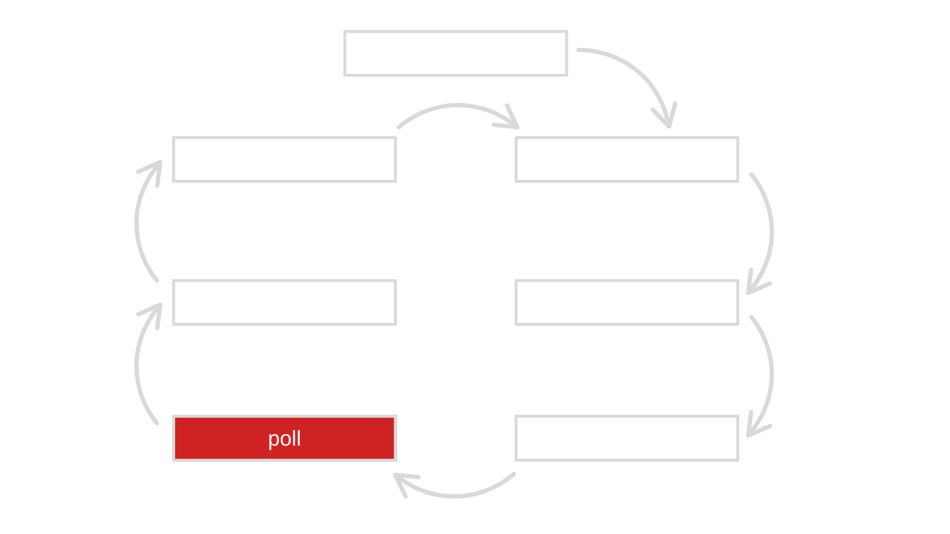

Slide 74
Poll phase
Two things happen in this phase
IO is being polled
Listen on sockets
Read/write connections
Accept connections
Read/write files
Callbacks are executed
OnRead -> if a file finished reading do this
onConnect → if a connection is established do this
onListen → if a socket is listening do this
Dynamic imports are also here

Slide 75
Blocking
Node will block in poll phase
Only when there isn’t anything going on
E.g. epoll_wait for connections
Except when there are timers!
epoll_wait with a timeout

Slide 76
How does IO work in Node
IO in Node is asynchronous
Enabled by the lib_uv library
Network IO is implemented differently from file io
Depends on kernel
We will discuss this in detail in future sections

Slide 77
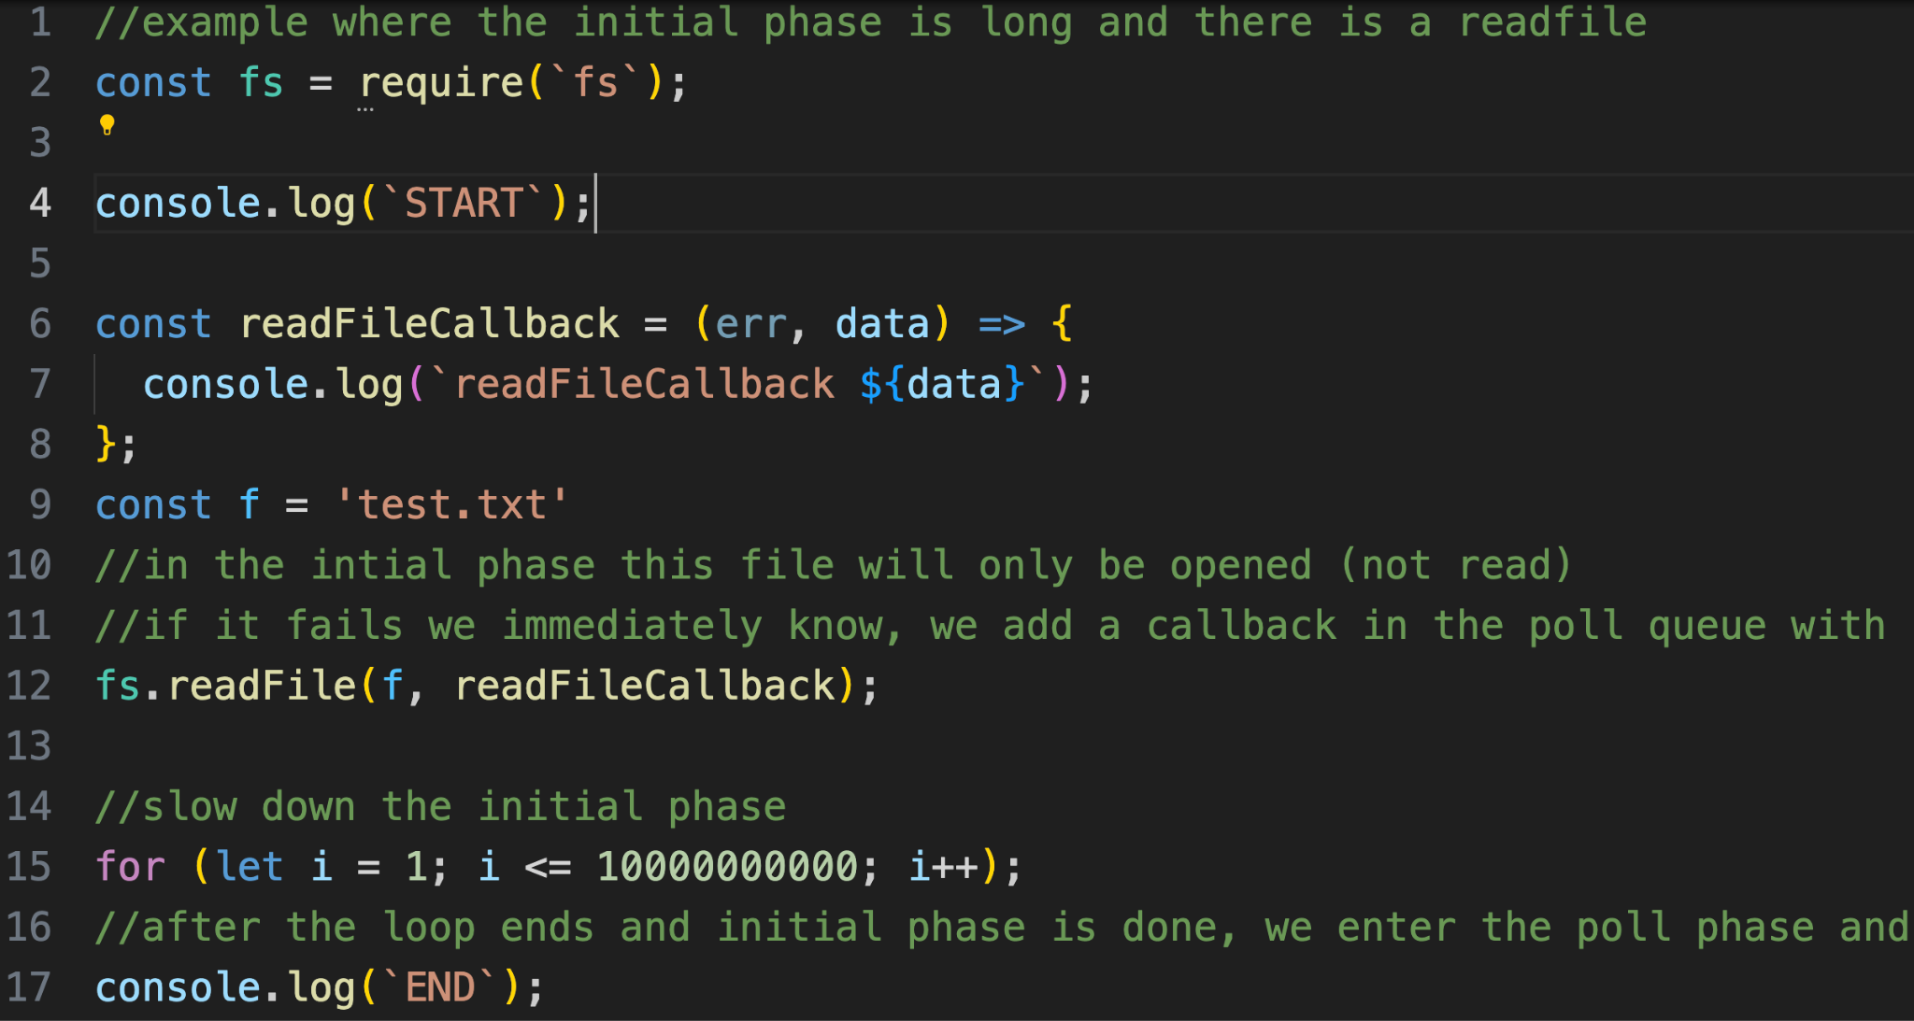
Example - readFile file io
Open is called in initial phase , read is called on the poll phase , once read is ready, callback is added and executed.
Once initial phase is done, read is scheduled in the poll

Slide 78
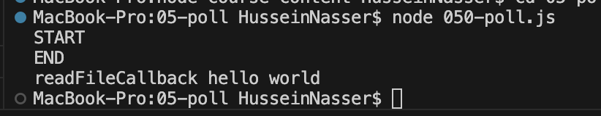
Example - readFile file io

Slide 79
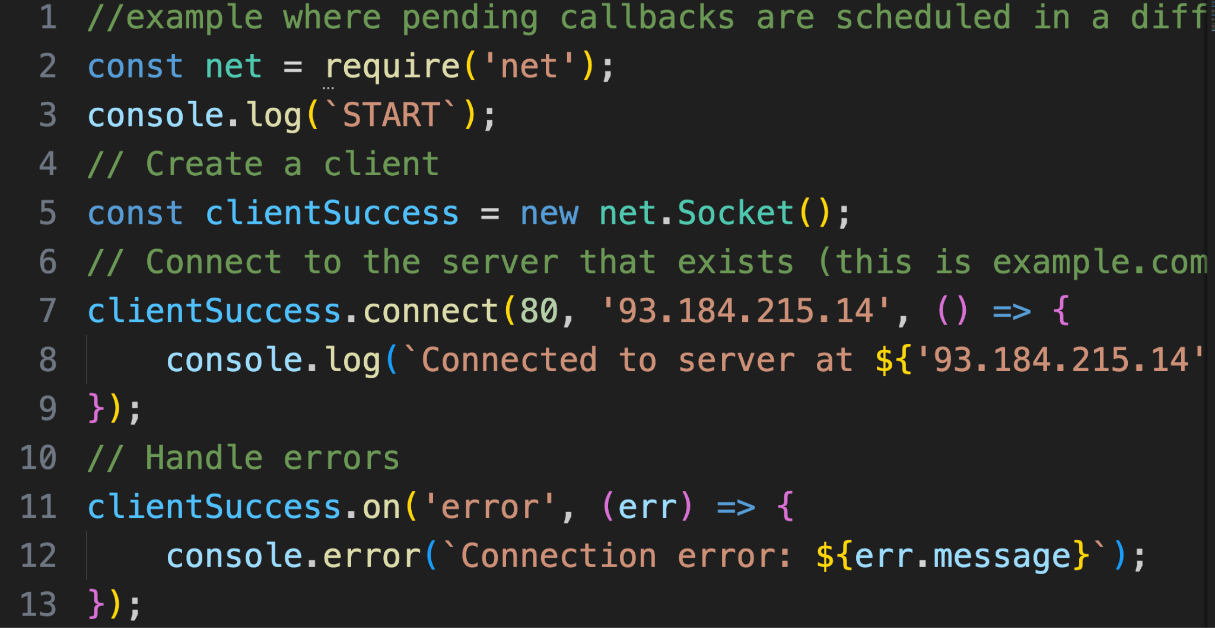
Example - Socket connect
A socket is created, and a SYN is sent
This happens during the poll phase

Slide 80
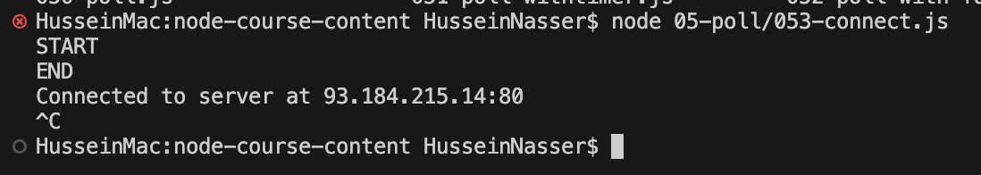
Example - Socket connect
Keeps running until we control c or close all connections (why?)

Slide 81
Why does Node keep running after connect?
If there is at least client connection, Node loops and keeps reading
Until all connections closed
Same for listening socket

Slide 82
Summary & Demo
Poll phase executes io events and callbacks
IO Callbacks can be scheduled by any phase
IO can be blocking and non-blocking
Node tries to not block if there are other work
Code exercise →
Readfile
Readfile with timer
Failed readFile
Server listen

Slide 83
check
husseinnasser
Phase to execute things while waiting

Slide 84
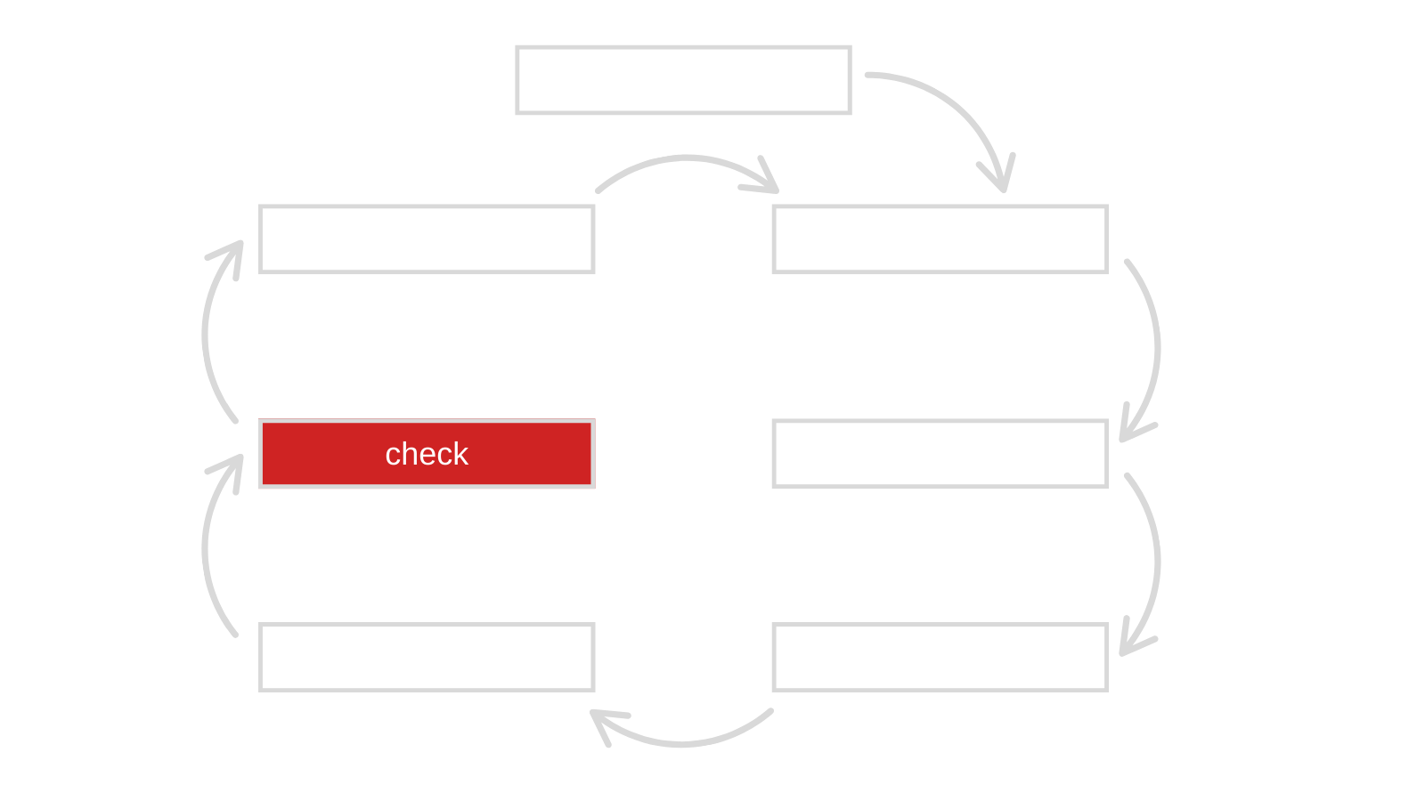

Slide 85
Check
Execute code right after poll phase
Or if the poll phase is busy waiting
setImmediate is the function to schedule check callbacks
Use it for deterministic outcome
Always executed after poll and before timer

Slide 86
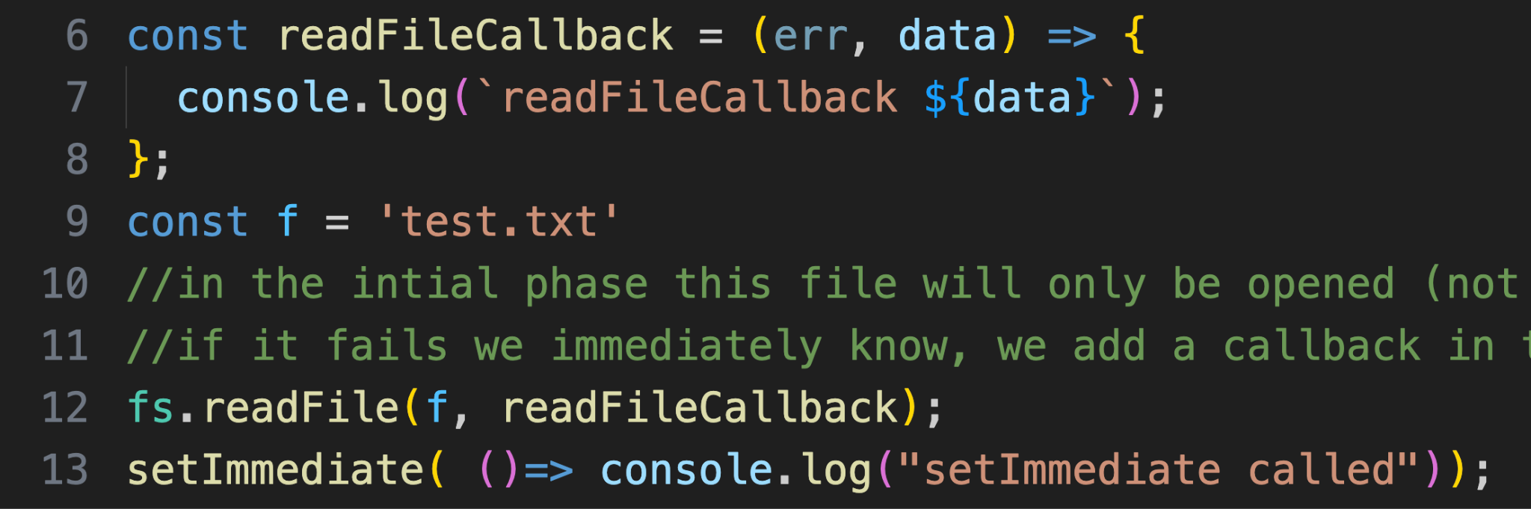
Example
Read file is scheduled poll phase
setImmediate callback in the check phase

Slide 87
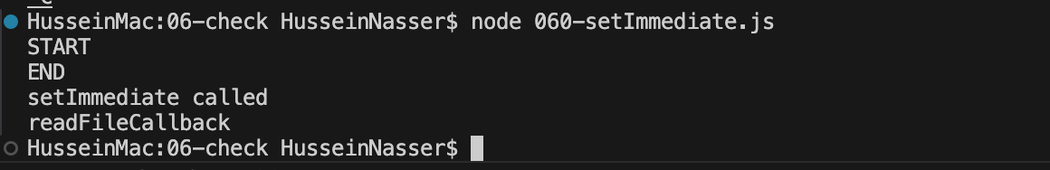
Example (file exists)
Output when file exists..

Slide 88
Example (File doesn’t exists)

Slide 89
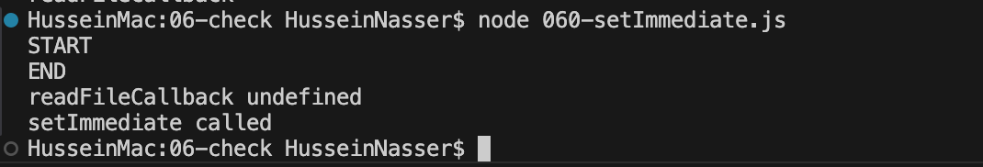
Example (File doesn’t exists)
Output when file doesn’t exist (why?)

Slide 90
Summary & Demo
Check phase is in lock step with poll phase
Execute code as soon as the poll phase ends/idles
Difference setTimeout vs setImmediate
Code exercise →
setImmediate vs timer

Slide 91
close
husseinnasser
Where close callbacks are scheduled

Slide 92
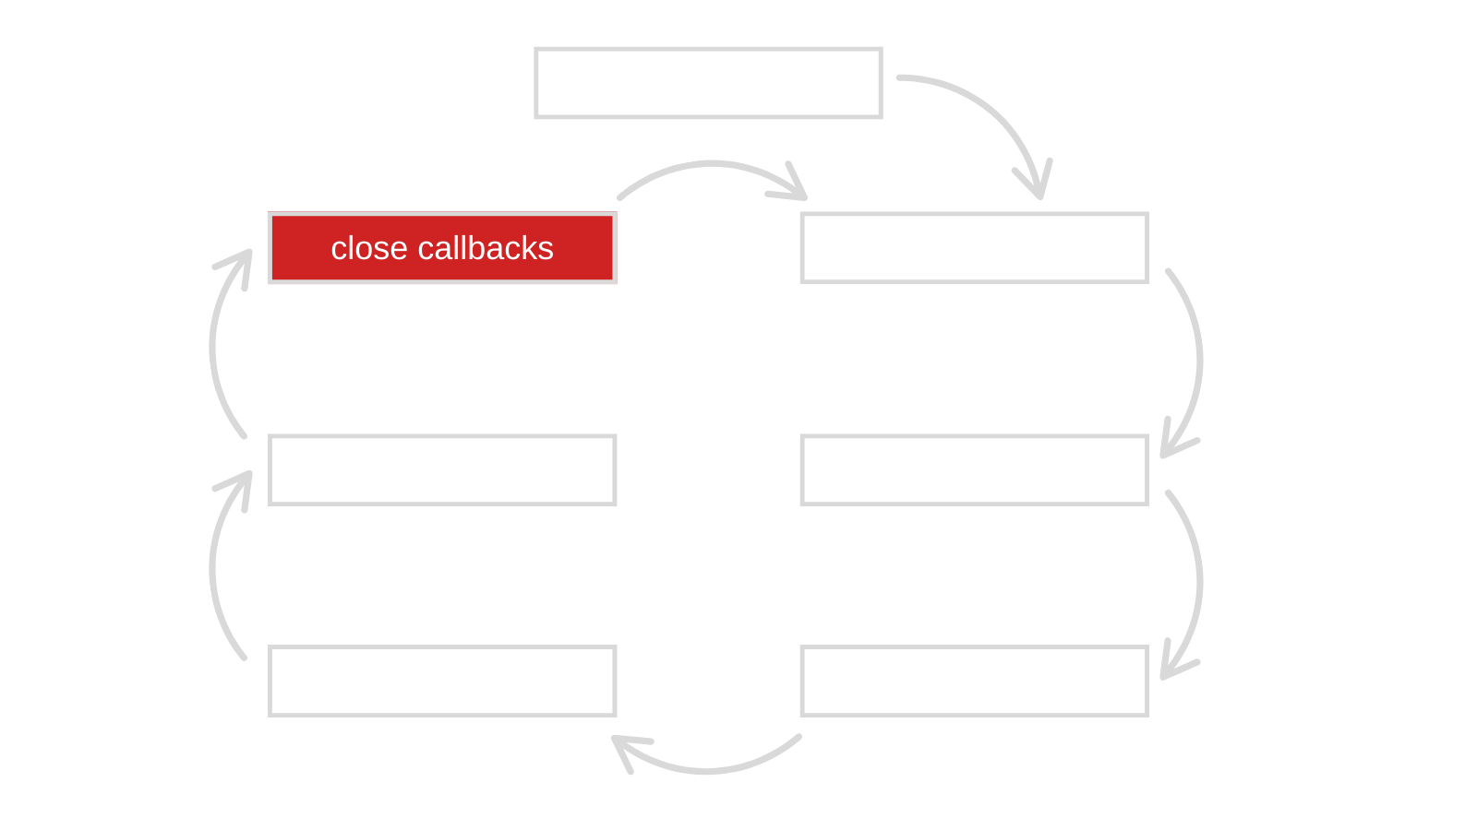

Slide 93
close
Close events happen here
Clean up phase
E.g. a connection being terminated
Connection terminates is still an IO (poll)
Wait for poll and fire the close to “clean up”
E.g. socket.close event (TCP close handshake)

Slide 94
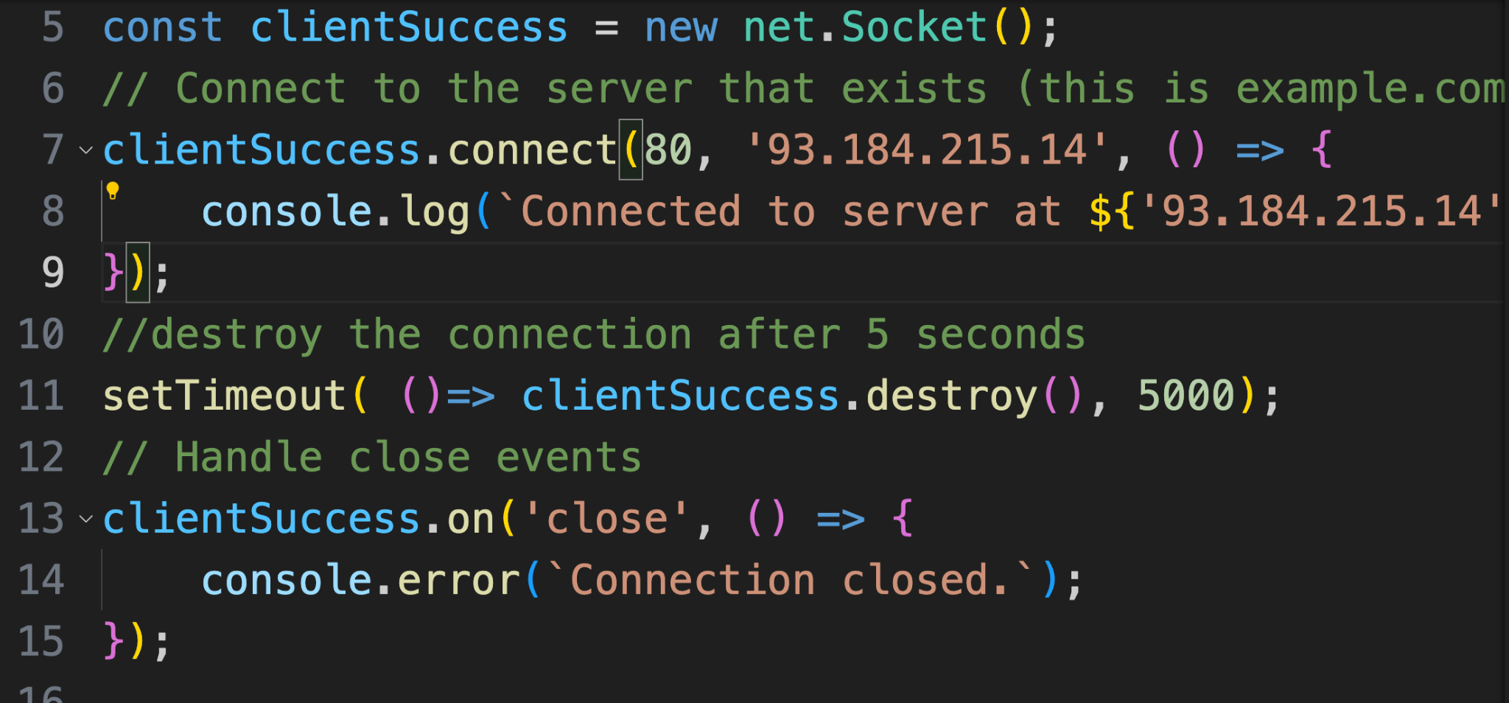
Example
Destroy the socket after 5 seconds, the “destroy” is an IO which is scheduled in the poll phase, once it's done, the close callback event is scheduled on the close phase
This will run in the close phase (last), after everything in that iteration is done

Slide 95
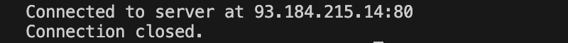
Example
This will trigger after 5 seconds

Slide 96
Summary & Demo
close phase executes after the check phase
For clean up purposes
Code exercise →
TCP Connection close

Slide 97
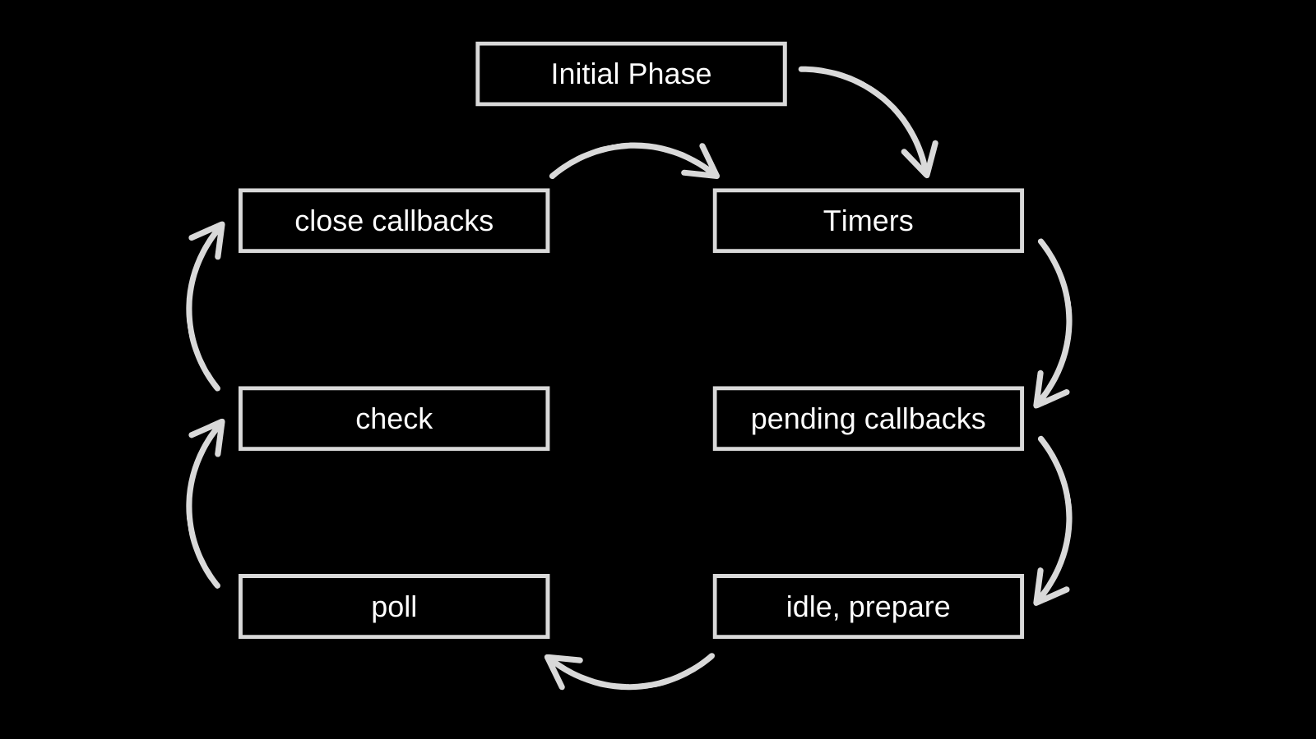

Slide 98
process.nextTick()
husseinnasser
Hidden phase

Slide 99
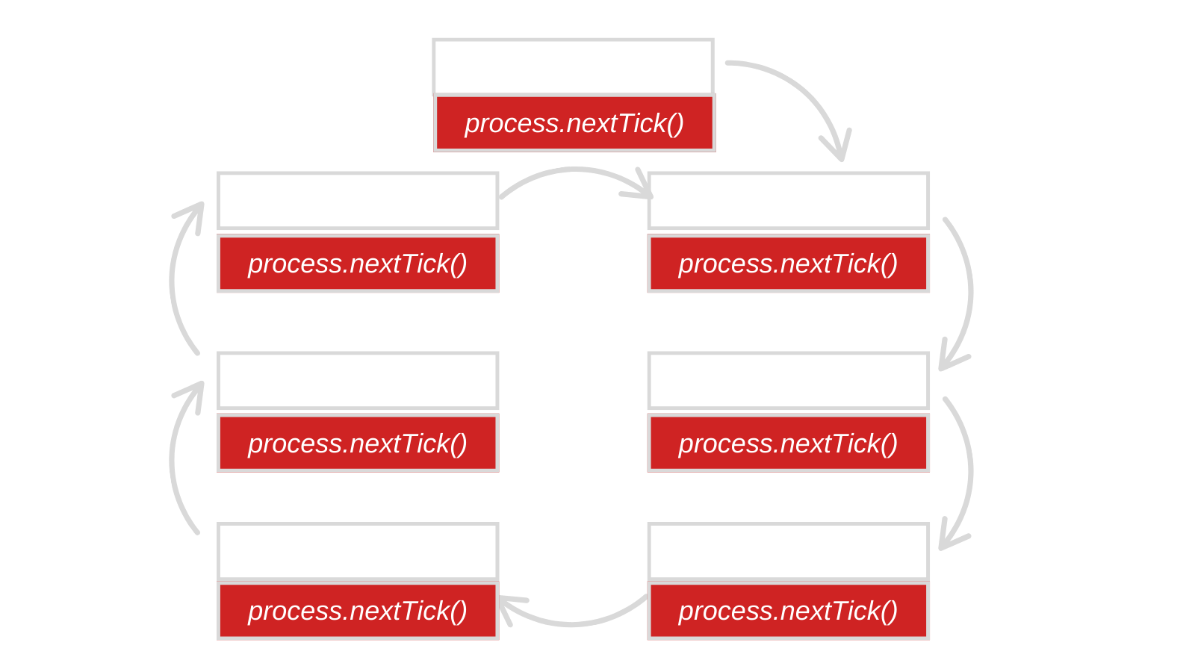

Slide 100
process.nextTick()
Node runs C++
When jumping from C++ to JavaScript we call it a ‘tick’
process.nextTick executes after each Tick
Roughly after each phase
Priority code (even before setImmediate)
Promises are scheduled here too!

Slide 101
Why not setTimeout (0)?
setTimeout is delayed until the timer phase
nextTick executes as soon as the current phase is finished

Slide 102
NextTick tells you when initial phase ends
The first nextTick is right after initial phase
Good indicator to know when did the initial phase really end
And when did the event loop about to start

Slide 103
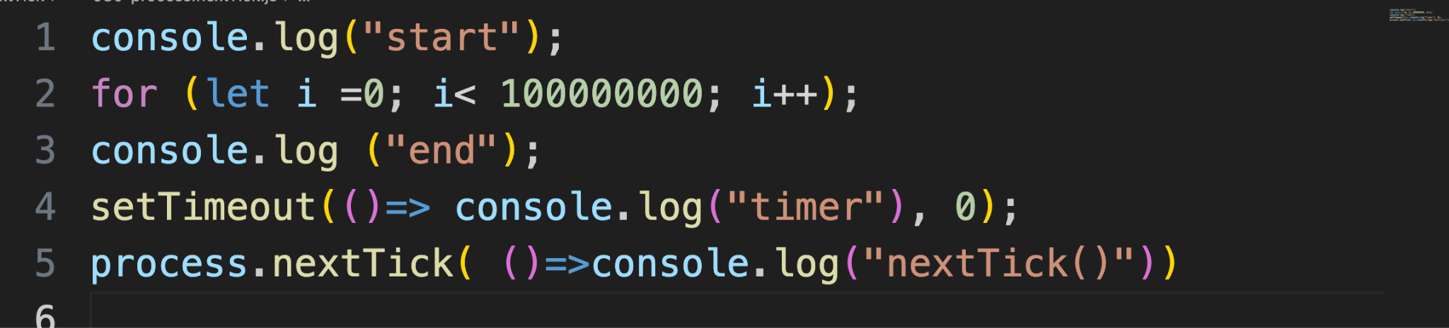
Example
Schedules nextTick after initial phase and before timer

Slide 104
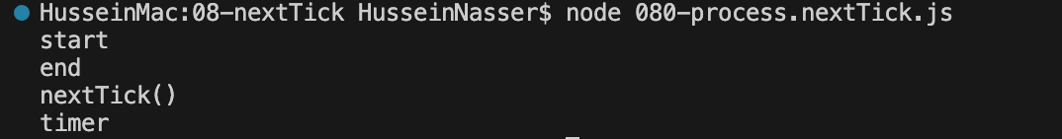
Example

Slide 105
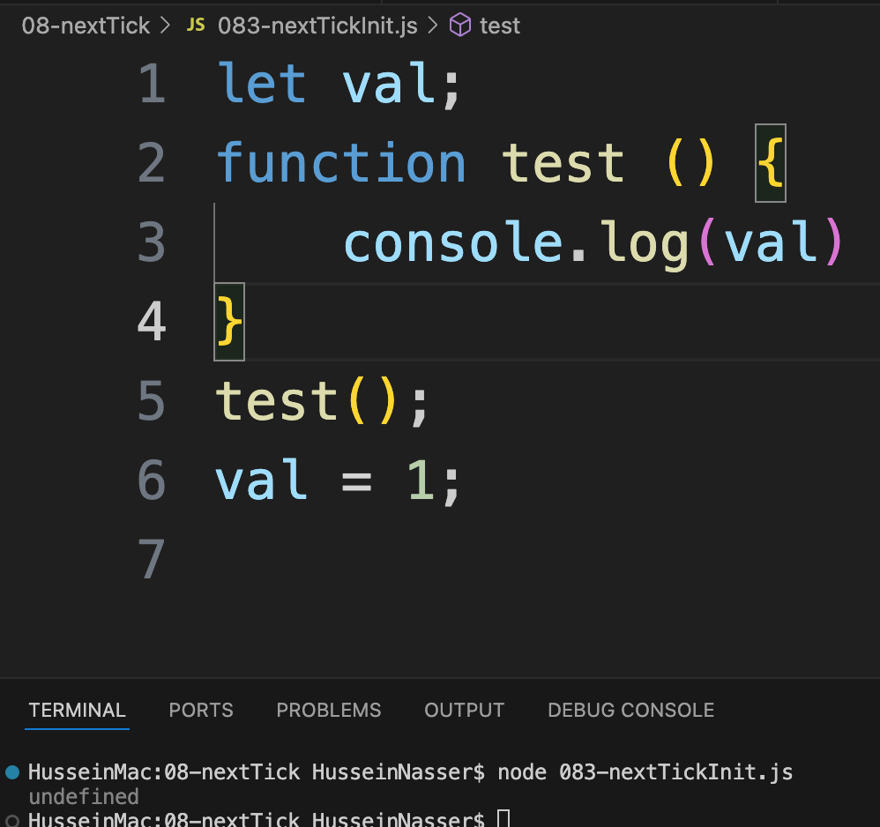
Another example
The output here is “undefined” because the initial phase executed synchronously and test is called before val is initialized

Slide 106
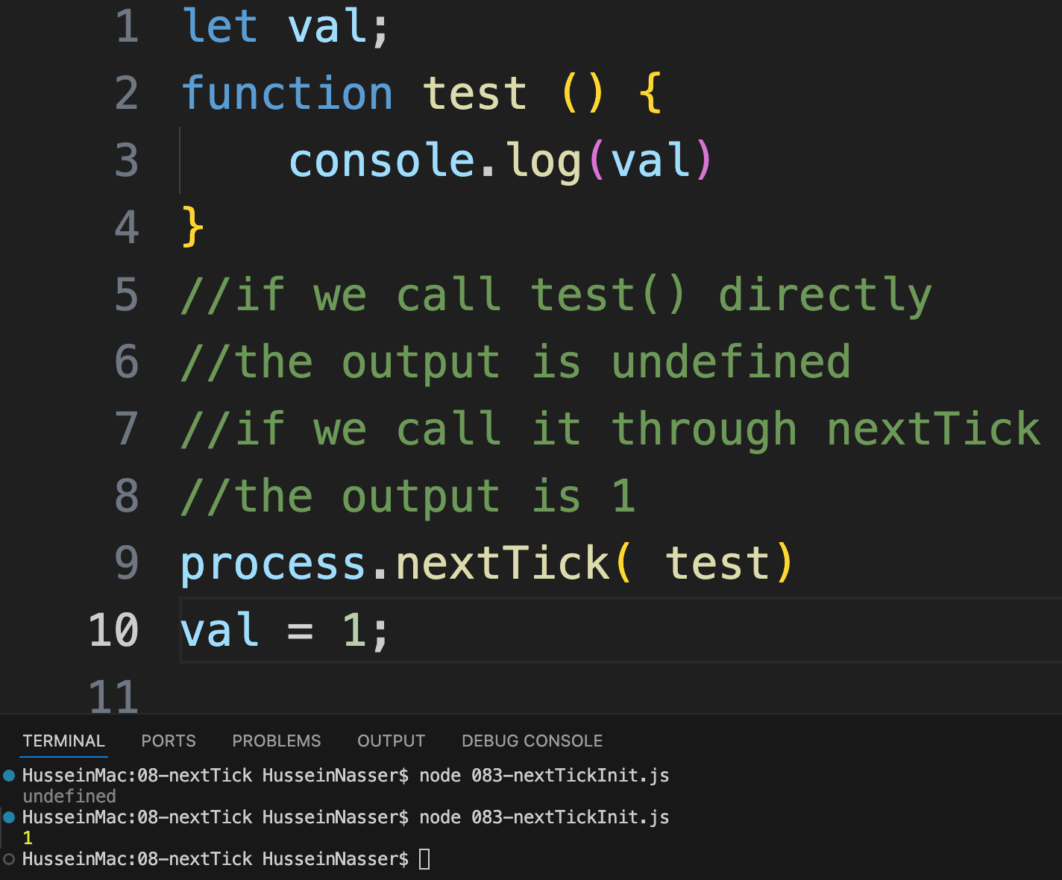
Another example
By scheduling process.nextTick we let the main phase initialize, and the output is now 1 (because val is now initialized)
Powerful for modules too.

Slide 107
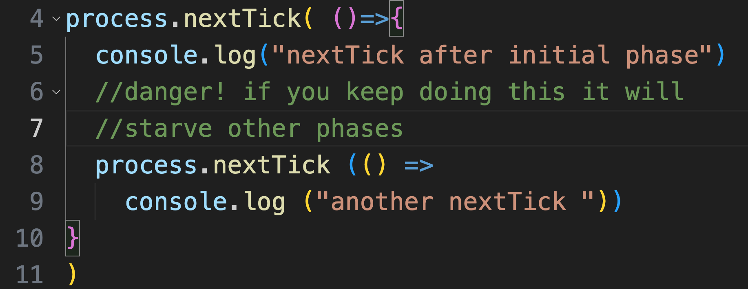
Danger!
Don’t schedule nextTick in nextTick!
Recursive will starve other phase (like poll)
It won’t go into nextTick, it will go into the current “Tick”

Slide 108
Summary & Demo
process.nextTick can be used for priority workload
Waiting for the current phase to finish
Executes after each phase
Watch out scheduling nextTick inside nextTick
Code exercise →
nextTick examples

Slide 109
How Promises Work
husseinnasser
What is behind promises

Slide 110
Promises
Callbacks are hard to read
Promises are syntax sugar on top of callbacks
Async await made it better
It looks synchronous but its asynchronous
Promises callbacks are scheduled in the process.nextTick

Slide 111
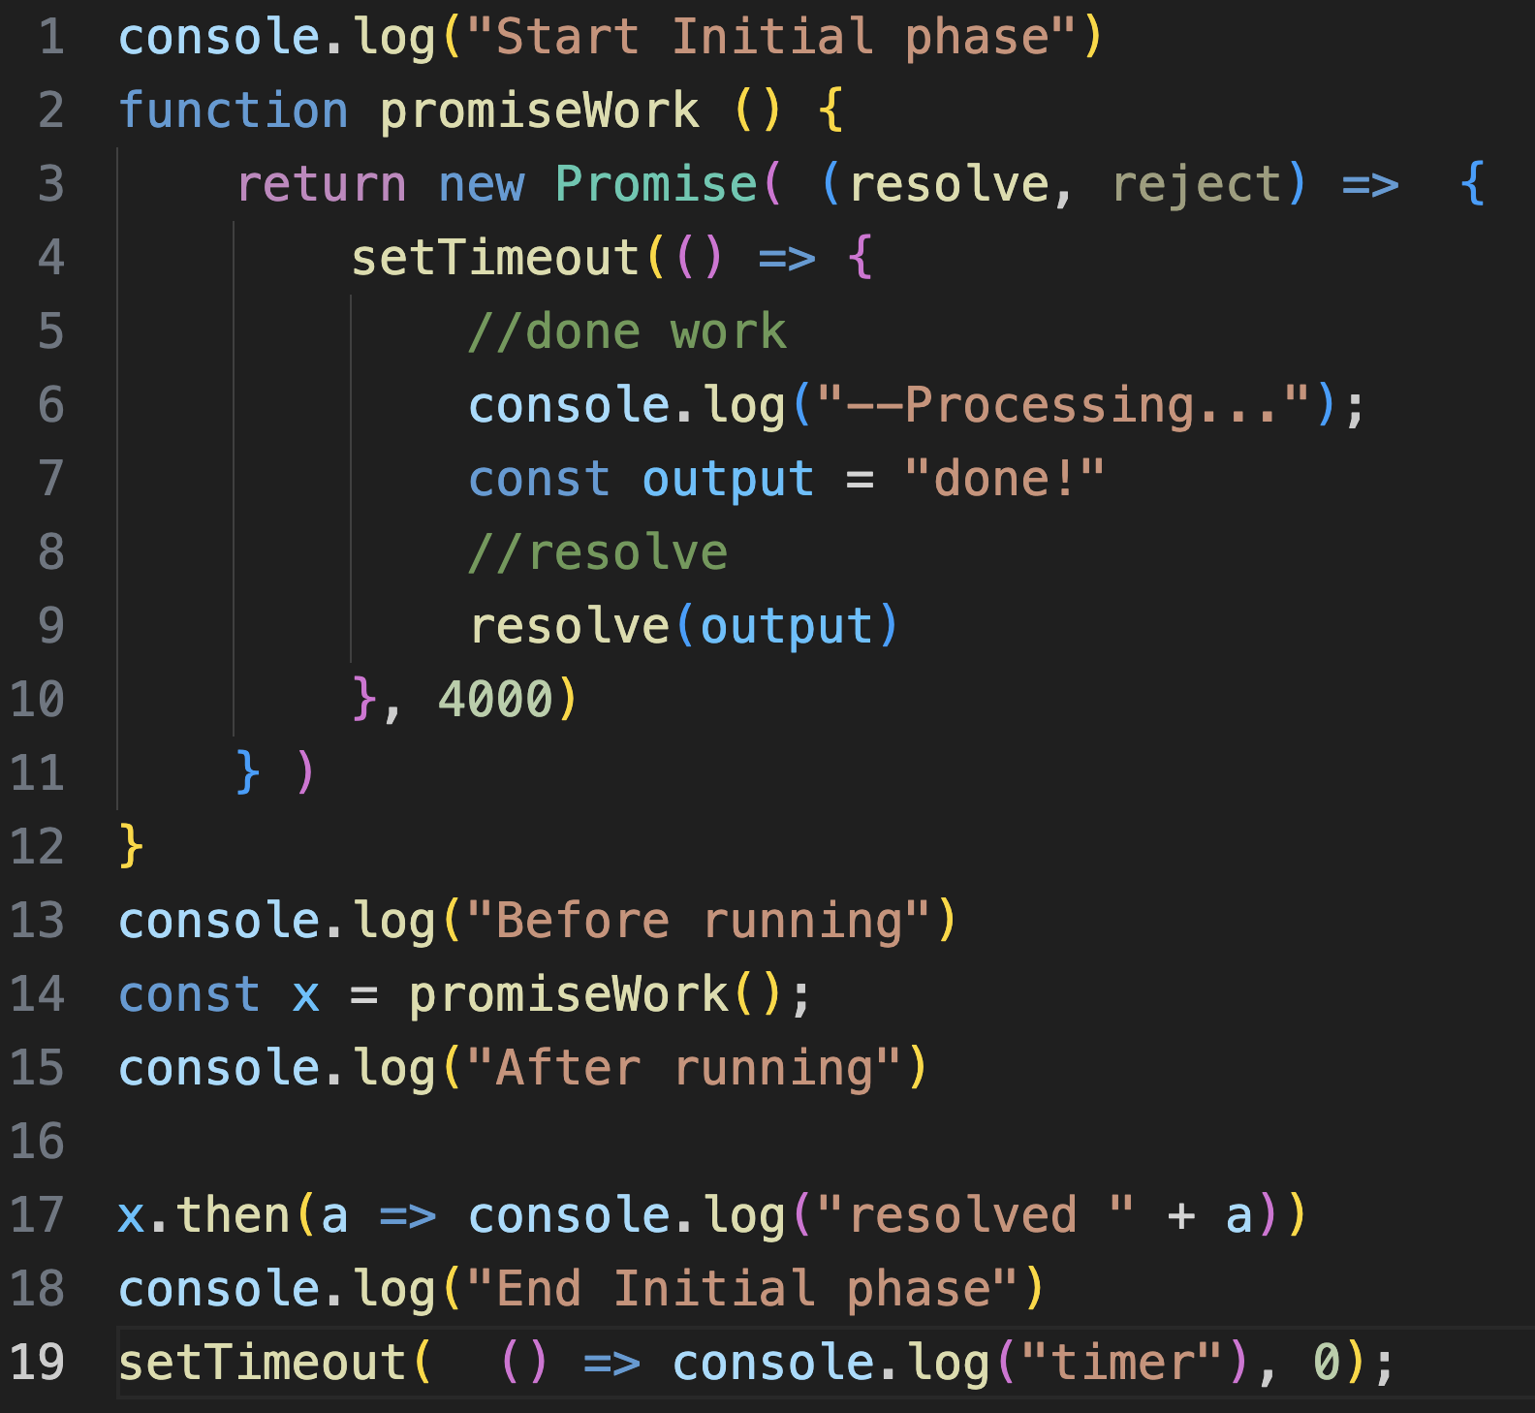
Example
“Then” is called when resolve is called
catch is called when reject is called
Async, just powers through..
Then is called when it is resolved

Slide 112
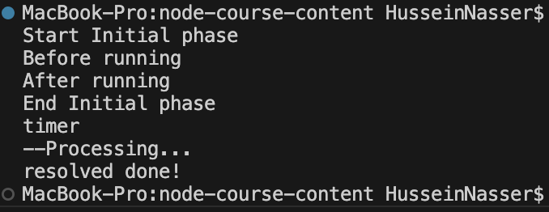
Example

Slide 113
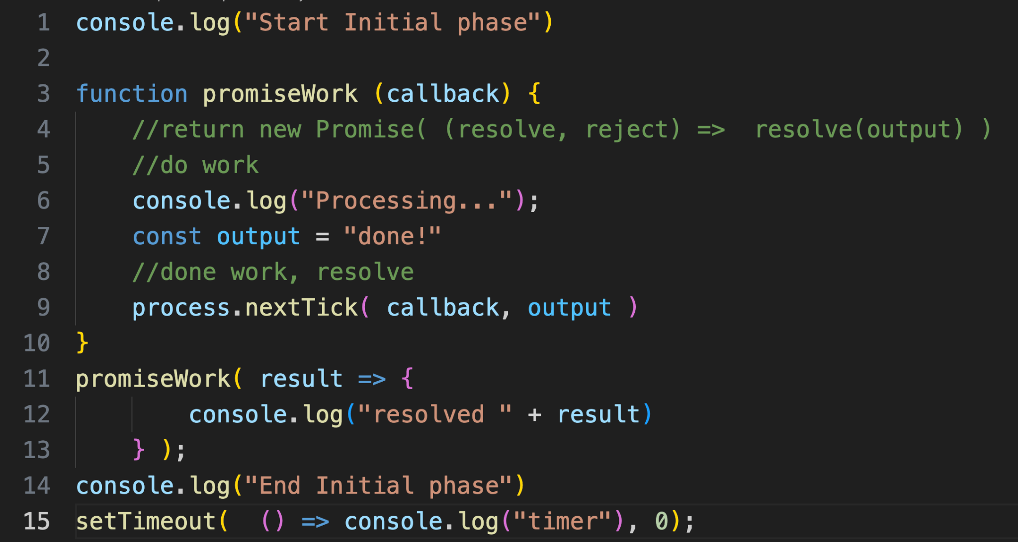
Implement with nextTick
This schedules the callback in the nextTick

Slide 114
Async wait?
Simulate synchronous execution
Still callbacks
Anything after the “await” gets scheduled as a callback
More like a pointer, go “here” after resolving the promise

Slide 115
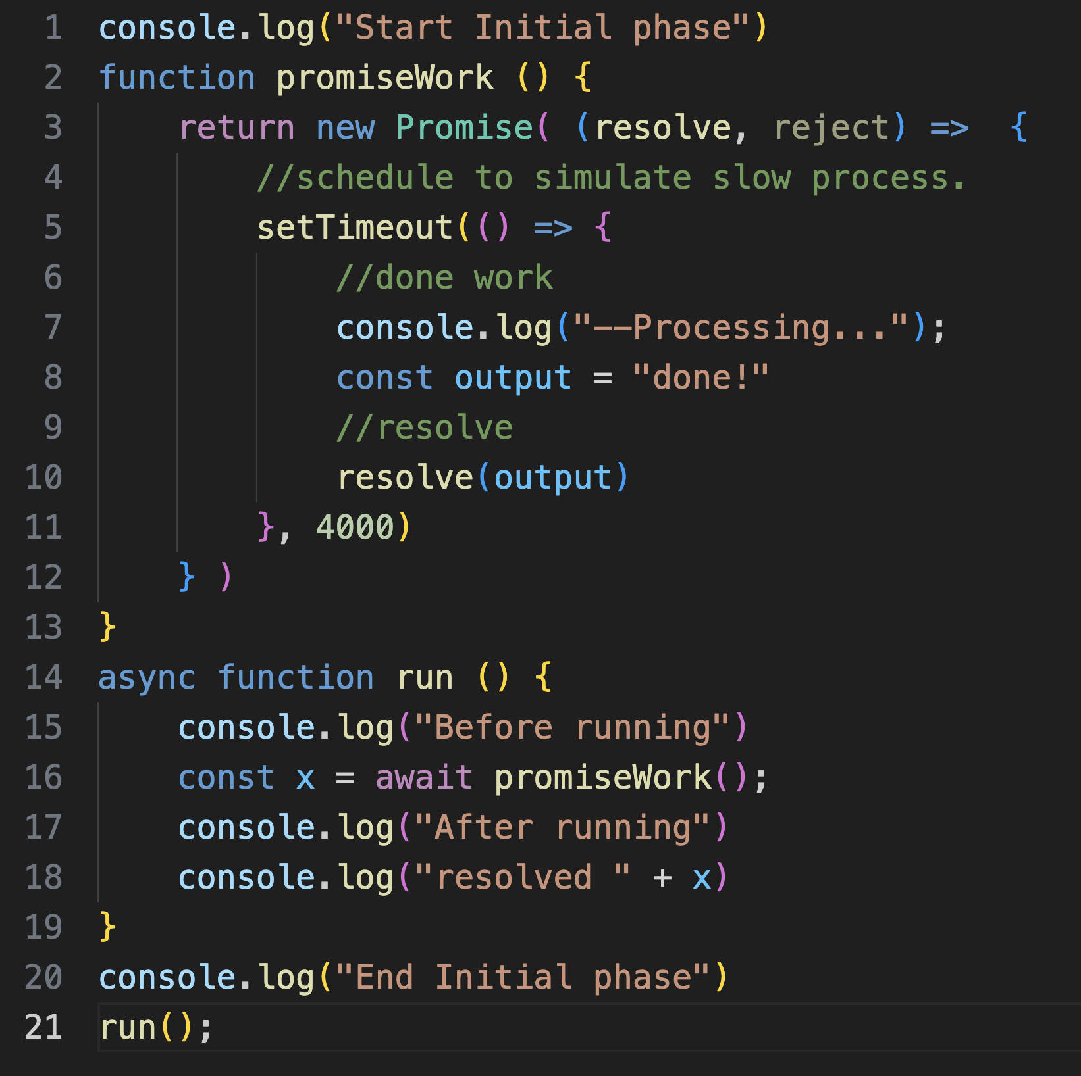
Example
The callback is resolved when resolve is called.
The callback is this line, callback points to this line after promise is resolved

Slide 116
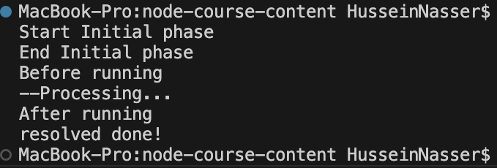
Example async await

Slide 117
Summary & Demo
Promises are implemented as callbacks
Run on nextTick
Its asynchronous
Async await make it “look” synchronous
Code exercise →
Promises vs callbacks examples
Make readFile into a promise

Slide 118
require vs import
husseinnasser
Importing modules

Slide 119
Importing module
Node main.js
main.js
Importing module is useful
Libraries, functions
Reads file from disk + parse it + execute
Load work relative to file
But when do they load?
c.js
a.js
b.js

Slide 120
require
CommonJS syntax
Synchronously loading modules
Mostly done in the initial phase
Supports conditionals
Can also be called during event loop
Timer, Poll etc.
Can be used in .js only

Slide 121
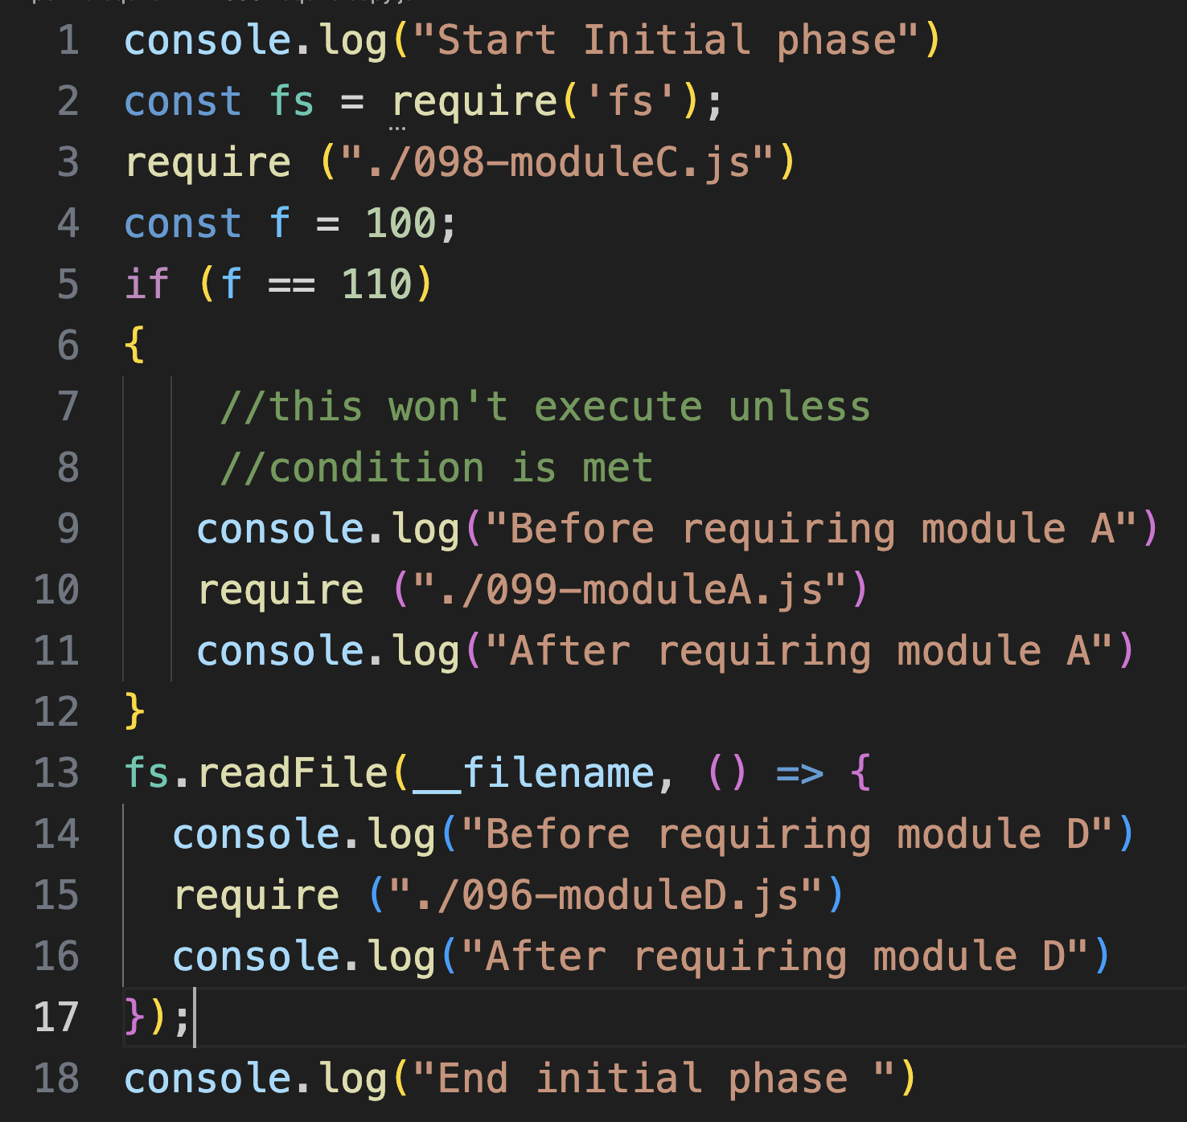
require example
Loads in initial phase
Module A won’t load because it doesn’t fit the condition
Module D will load during poll phase (after initial phase)

Slide 122
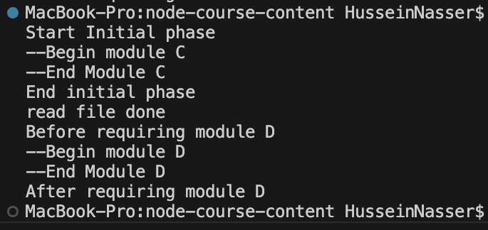
require example

Slide 123
Import
Asynchronous
Executes in the poll phase
Returns a promise
Get scheduled just like any other io
Can be used in .js and .mjs
Can be awaited to give synchronous feel
Import x from is different.

Slide 124
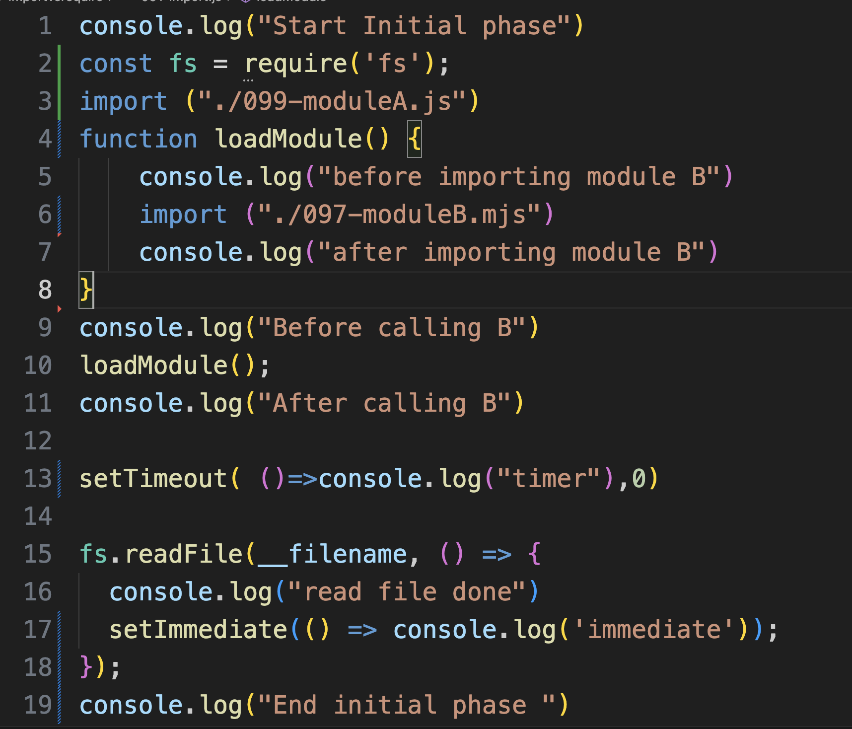
Example
Get scheduled in poll phase
Adding those for reference

Slide 125
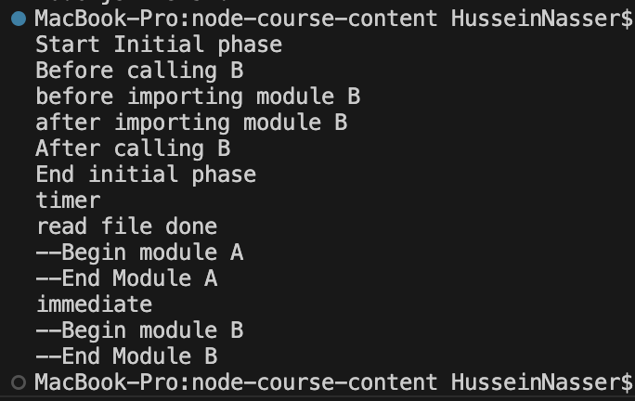
Example

Slide 126
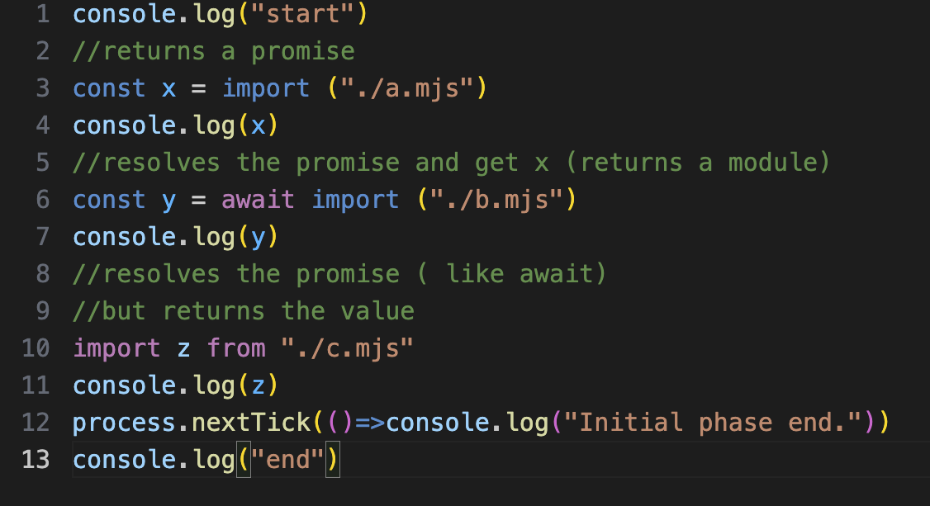
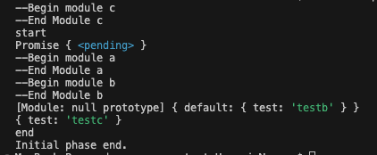
Import x from is the exception
Loads immediately before initial phase

Slide 127

Import x from is the exception
Must be at the top
Can’t be done in conditionals blocks

Slide 128
Summary & Demo
Require loads modules synchronously often in initial phase
Import loads modules asynchronously in the poll phase
Code exercise →
Require vs import
Async await import

Slide 129
The Anatomy of Node Packages
husseinnasser
Breaking it down

Slide 130
Packages
You can work with individual files with Node
But dependencies become challenges
meet packages

Slide 131
package.json
Manifest of the current package and all its dependencies
semantic versioning
"fetch": "^1.1.0",
Means install version 1.1.0 or later but don’t go beyond major release 1.,
ie anything after 1.1.0 and under < 2.0.0
"crepe": "~7.6.0",
Means install version 7.6.0 or later but don’t go beyond minor 6
Ie anything after 7.6.0 and under < 7.7.0
Only has the direct dependencies for this package

Slide 132

package.json

Slide 133
package-lock.json
Package.json describes the latest possible
But we need to know each package version and their dependencies
Meet package-lock.json
Snapshot of what the dev installed exactly
Used for consistency
Has ALL dependencies of packages

Slide 134

package-lock.json

Slide 135

node_modules
Downloaded packages go to node_modules folder
Loading modules/packages by looking up this folder
Contains all downloaded packages
Based on package-lock.json

Slide 136
Package manager
You can do this yourself (if you want)
OR use a package manager that
hosts and manages packages
Download and install packages
Updates package.json and package-lock.json
Updates the package.json package-lock.json
Downloads to node_modules
example npm , yarn
npm init creates a package.json

Slide 137

Main package
fetch
lodash
encoding
biskviit
iconv-lite
psl
Leaf package
safer-buffer
punycode

Slide 138
Considerations
You don’t push node_modules to git
Its massive, and you can always generate it from package-lock.json
You push package.json and package-lock.json
package.json is the source
Package-lock.json is the snapshot
This way all clients have repeatability

Slide 139
Summary & Demo
Packages makes dependencies easier
Managed by package manager
3 files package.json, package-json, node_modules
Code exercise →
Create package json
We want reference node-fetch
View the latest using npm view node-fetch
E.g. Latest version 3.3.2, we want a specific version 3.3.1

Slide 140
When does Node terminate
husseinnasser

Slide 141
When does Node terminate?
When there is nothing to do
But why does Node sometimes doesn’t terminate?
When we call a socket listen there are things to do
They are things to do they just not visible to you
Another reason to understand the fundamentals

Slide 142

Example , Connection
Ones a connection is created, node will keep reading from it until it is closed

Slide 143

Example , Server
Ones a socket is listening Node will keep calling accept on it until it is closed.

Slide 144
Summary & Demo
Node looks like it is not doing anything but it is
Connections, sockets
Code exercise →
Client connection
Server listener

Slide 145
Node Internals
husseinnasser
Diving Deeper

Slide 146
Libuv Overview
husseinnasser
Libuv design

Slide 147
libuv
The IO library behind NodeJS
Does event loop, polling, networking and file operations
Cross platform

Slide 148

Libuv components

Slide 149

IO loop
Almost 1-1 with Node JS loop

Slide 150
Libuv thread pool
A pool of threads dedicated for certain tasks
Can be configured with UV_THREADPOOL_SIZE
Default 4
Only used by
File IO (async)
DNS
Some user code and libraries (crypto)

Slide 151
Network IO
All network IOs are done asynchronously
Depending on the OS
epoll ->Linux
Kqueue ->BSD (mac)
Event ports (solaris)
IOCP (Windows)

Slide 152

File IO
File cannot be done asynchronous (iouring is the exception)
So libuv does a blocking read on a thread
Keeps the main thread unblock
Simulates asynchronous

Slide 153
Summary
Node uses Libuv
For IO loop
For asynchronous IO
File/network IO is different, more in next lecture

Slide 154
Asynchronous IO
husseinnasser
Non blocking reads and writes

Slide 155

Blocking operations
Read, write and accept are blocking
The process cannot move their Program counter
Read blocks when no data
accept blocks when no connections
Leads to context switches and slow down
Process
OS kernel

Slide 156



Blocking operations
read
con1
read
con2
read
con3
con4
con5
con6
con7
con8
con9
This is just a pseudo code for simplicity, green indicates the receive buffer for the connection has data to be read, gray indicates an empty receive buffer (client hasn’t sent anything). In this example the process gets blocked on reading connection 3 until some data arrives there, while the other connections are starved.
con10

Slide 157
Asynchronous I/O
Read blocks when no data in receive buffer
Accept blocks when no connections in accept queue
Ready approach
Ask the OS to tell us if a file is ready
When it is ready, we call it without blocking
Select,epoll, kqueue
Completion approach
Ask the OS (or worker thread to do the blocking io)
When completed notify
IOCP, io_uring
Doesn’t work with storage files

Slide 158

Select (polling)
Select takes a collection of file descriptors for kernel to monitor
Select is blocking (with a timeout)
When any is ready, select returns
Process checks which one is ready (loop w/FD_ISSET)
Process calls read/write/accept etc. on the file descriptor

Slide 159

select
con1
con2
con3
con4
con5
select
con6
con7
con8
con9
In this example, only connection 9 has data in the receive buffer, but client is monitoring all 10 connections. The select call sends all 10 file descriptors, kernel checks one by one (all 10) discovers the connection 9 had data, unblocks and return
con10

Slide 160
select
con1
con2
con3
con4
con5
con6
con7
con8
con9
read
The client then gets its program counter incremented, loops through all connections and check which one is ready O(n). It finds that connection 9 is ready and issues the read on it with no blocking.
con10

Slide 161
Select pros and cons
Pros
Avoid reading (unready) resources
async
Cons
But slow we have to loop through all of them O(n)
Lots of copying from kernel/user space
Supports fixed size of file descriptors

Slide 162

epoll (eventing)
Register an interest list of the fds (once) in the kernel
Kernel keeps working and updates the ready list
User calls epoll_wait, kernel builds an events array of ready list
Process
epoll_create con1,con2,con3 (1)
OS Kernel
epoll_wait (3)
events (4) - con3
con1
Incoming
Packets con3 (2)
con2
con3

Slide 163

epoll
epoll e (kernel)
con1
con2
con3
con4
con5
con6
con7
con8
con9
Again this is pseudo code, we first create the epoll_instance, which lives in the kernel memory. Then we add the connections/file descriptors
con10

Slide 164
epoll
epoll e (kernel)
con1
con2
Events ready list:
[con4, con9]
con3
con4
con5
con6
con7
con8
con9
The code process moves on, meanwhile the kernel keeps receiving packets and as it does so, it will populate the ready list for those connections with data. In this case we got data for con9 and con4
con10

Slide 165
epoll
epoll e (kernel)
con1
con2
Events ready list:
[con4, con9]
con3
con4
con5
con6
con7
con8
con9
At some point, code calls epoll_wait, if the epoll instance is empty wait is blocked, else we immediately send back the array of events to the user space. Only what is ready. Events count is now 2 elements.
con10

Slide 166
epoll
epoll e (kernel)
con1
con2
Events ready list:
[]
con3
con4
con5
con6
con7
con8
con9
the user calls read as non-blocking on connection 9 and connection 4 emptying the receive buffers.
con10

Slide 167
epoll drawbacks
Complex
Level-triggered vs edge-triggered
Only in linux
Too many syscalls
Doesn’t work on files

Slide 168
io_uring
Based on completion
Kernel does the work
Shared memory, user puts “job”
kernel does the work and writes results

Slide 169
io_uring
Based on completion
Kernel does the work
Shared memory, user puts “job”
kernel does the work and writes results

Slide 170
io_uring
User process
Process writes a job to the submission queue tail
Process consumes results from the head
Shared memory
read()
write()
read()
write()
Submission
queue
write()
accept()
Completion queue
accept()
accept()
read()
Kernel writes completed job results in the tail
Kernel pops jobs from the head
Kernel

Slide 171
io_uring
Fast, non-blocking
Security is a big issue (shared memory)
Google disabled it for now

Slide 172

Cross platform
Node (through lib_uv) supports all platforms async io

Slide 173
Summary
Some kernel syscalls are blocking
Process put to sleep
Asynchronous io is a way around it
Ready based or completion based

Slide 174
Node Network IO
husseinnasser
Network operations

Slide 175


Network IO
Connect to a listening server
Client side: Create connection on the client
Accept connections from listening Sockets
Server side: Create connections on the server
Read data from a connection
Client and server: Reading from connections
Write data to a connection
Client and server: Writing to a connections

Slide 176


10.0.0.3
10.0.0.2
10.0.0.3 wants to connect to a 10.0.0.2 on an open port 8080

Slide 177
Socket listener
(10.0.0.2: 8080)
Fd:19
on.listening-> fired
10.0.0.3
10.0.0.2
10.0.0.2 listens on 8080 socket, gets fd 19 listening socket. Fires on listening event

Slide 178
Socket listener
(10.0.0.2: 8080)
Fd:19
Attempt to connect to 10.0.0.2:8080
10.0.0.3
10.0.0.2
10.0.0.3 attempts to connect to 10.0.0.2:8080

Slide 179
Socket listener
(10.0.0.2: 8080)
Fd:19
Attempt to connect to 10.0.0.2:8080
SYN
SYN/ACK
ACK
10.0.0.3
10.0.0.2
Three way handshake happens

Slide 180
Connected to
10.0.0.2:8080
Connection accepted!,
Fd 20:
10.0.0.2:8080
10.0.0.3:53444
Connection created,
Fd 18:
10.0.0.2:8080
10.0.0.3:53444
Socket listener
(10.0.0.2: 8080)
Fd:19
on.connection-> fired
on.connect-> fired
10.0.0.3
10.0.0.2
Successfully connected, server accepts the connection gets a new fd 20, fires on connection event. client also gets a connection fd 18. Fires on connect event.

Slide 181
Connection created,
Fd 20:
10.0.0.2:8080
10.0.0.3:53444
Connection created,
Fd 18:
10.0.0.2:8080
10.0.0.3:53444
Socket listener
(10.0.0.2: 8080)
Fd:19
Connection
Fd 21:
10.0.0.2:8080
10.0.0.4:51111
Connection
Fd 17:
10.0.0.2:8080
10.0.0.4:51111
10.0.0.3
10.0.0.2
Another client connects,
Server accepts the connection fd 21.
10.0.0.4

Slide 182
10.0.0.3 Write “hello”
Socket listener
(10.0.0.2: 8080)
Fd:19
write(18, hello)
Fd 20:
8080:53444
Fd 18:
8080:53444
hello
Fd 21:
8080:51111
Fd 17:
8080:51111
10.0.0.3
10.0.0.2
10.0.0.4

Slide 183
10.0.0.2 receives “hello”
Socket listener
(10.0.0.2: 8080)
Fd:19
read*(20)-->on.data fired
Fd 20:
8080:53444
Fd 18:
8080:53444
hello
Fd 21:
8080:51111
Fd 17:
8080:51111
10.0.0.3
10.0.0.2
*Node doesn’t expose read, it is implicit called.
10.0.0.4

Slide 184
10.0.0.2 writes “world”
Socket listener
(10.0.0.2: 8080)
Fd:19
write(20, world)
read(18)-->on.data fired
Fd 20:
8080:53444
Fd 18:
8080:53444
world
Fd 21:
8080:51111
Fd 17:
8080:51111
10.0.0.3
10.0.0.2
10.0.0.4

Slide 185

Example - Connection
Once a connection is established, a socket file descriptor is created (client side)
When data comes to the connection this is called.
Done via read syscall (response)
Issue a write syscall on the connection socket

Slide 186

Example - Listener Socket
This creates a listening socket file descriptor
Connection is accepted, connection file descriptor created (server side)
Client establishes a connection , gets a file descriptor

Slide 187
Summary & Demo
Node polls for IO
Accept, read, write
Code exercise →
strace node and epoll

Slide 188
Node File IO
husseinnasser
File operations

Slide 189
readFile
Opens, reads the entire file and closes the file
May keeps the file open
Cost of opening /closing/path resolving
Done asynchronously

Slide 190
readFileSync
MT
Executes right there and then (blocks)
On the main thread
Whatever phase we happen to be at
Including initial phase (watch out)
Once read is done, data is returned
readFileSync
UV1
UV2
UV3
UV4

Slide 191
readFile (asynchronous)
MT
Schedules execution to the poll phase
Executes on a lib_uv thread (blocks)
Once read is done, callback is scheduled
Main thread is not blocked
UV_THREADPOOL_SIZE controls it
UV1
UV2
UV3
UV4
readFile

Slide 192

Example

Slide 193

Example

Slide 194
Working with file descriptors
To avoid open/close you can open once get a file number
Issue a read with the file descriptor
Much faster, avoid path lookups.
Use open, close
Those has sync and async versions
Read(offset, buffer)

Slide 195

File system flags

Slide 196
File streams
readFile loads everything in memory
Can’t read large files
[ERR_FS_FILE_TOO_LARGE]: File size (7322357281) is greater than 2 GiB
Use streams
Will have dedicated lecture on streams

Slide 197

File streams
Issues multiple async file reads with fixed buffer size

Slide 198
Gotchas
The callback of readFile indicates the time the callback was executed
Not when the actual read has occurred/done
It possible the read has finished a while back but poll phase didn’t picked it up

Slide 199
Summary & Demo
Node file io
Sync vs async
Threads
Streams
Code exercise →
strace node file io
File read sync vs async
File read with file descriptors
File read with streams

Slide 200
Node HTTP
husseinnasser
HTTP module

Slide 201
HTTP
Hypertext transfer protocol
Request / Response
Node implements HTTP client and server
Supports HTTP/1.1 and HTTP/2
On top of TCP

Slide 202
Client / Server
(Client) Browser, python or javascript app, or any app that makes HTTP request
(Server) HTTP Web Server, e.g. IIS, Apache Tomcat, NodeJS, Python Tornado

Slide 203
HTTP Request
Method
PATH
Protocol
Headers
Body

Slide 204

HTTP Request

Slide 205
HTTP Response
Protocol
Code
Code Text
Headers
Body

Slide 206

HTTP Response

Slide 207


HTTP
open
close
80
GET /
Headers+ index.html
<html>...
….

Slide 208


HTTPS
open
close
443
Handshake
GET /
Headers+ index.html
<html>...
….

Slide 209
HTTP 1.1
open
close
80
GET /index.html
GET /img1.jpg
GET /img2.jpg
….

Slide 210
HTTP 1.1
Pipelining
open
close
80
GET /index.html
GET /img1.jpg
GET /img2.jpg
….

Slide 211
HTTP 1.1
Persisted TCP Connection
keepalive
Low Latency & Low CPU Usage
Fixed length response
Streaming with Chunked transfer
Proxying

Slide 212
HTTP Client
Client connects to a server
Client gets a connection
Client writes a request to the connection
Client gets back a response
Connection accepted!,
Fd 20:
10.0.0.2:8080
10.0.0.3:53444
Socket listener
(10.0.0.2: 8080)
Fd:19
Connection created,
Fd 18:
10.0.0.2:8080
10.0.0.3:53444
10.0.0.3
10.0.0.2

Slide 213
Node HTTP agent (http.Agent)
Agent
Client side
Supports pool of connections (per host)
Queue of requests
Keep socket alive to keep the connection alive
There is always an agent, a global one is default
Host1 sockets
Requests queue
Host2 sockets

Slide 214
Node Request (http.clientRequest)
Using an agent, send a request
If no agent is provided, use the global one
Pick a free connection and writes the request to it
If no free connection is available create one
Unless maxSockets is reached

Slide 215
Node Request (http.clientRequest)
Takes a URL
String or URL object (why?)
Parsing URLs isn't cheap, you can parse once and pass it.
And options
Method, path, headers, agent
Many more!
request

Slide 216

A look at URL anatomy
https://nodejs.org/api/url.html

Slide 217
Client on Response
Response event
We get a Readable stream
Backend writes headers, status then body on the socket
It only contains the headers, status code
Read can happen by assigning “data” event
Read it from the kernel to user space
Parse it
Encode it
response

Slide 218
When the response is ready
The on response callback is fired when a response is received
What does that mean?
Node reads from the connection
Parses the data until it gets the end of a response
Packages the response as object and puts it on the callback
Response start
< HTTP/1.1 200 OK
< Content-Type: text/html
< Date: Thu, 16 Jan 2025 00:04:36 GMT
< Content-Length: 30
< Connection: keep-alive
< <html><body>xxxx</body></html>
Response end
On response fires

Slide 219
Request options
agent <http.Agent> | <boolean> Controls Agent behavior. Possible values:
undefined (default): use http.globalAgent for this host and port.
Agent object: explicitly use the passed in Agent.
false: causes a new Agent with default values to be used.
auth <string> Basic authentication ('user:password') to compute an Authorization header.
createConnection <Function> A function that produces a socket/stream to use for the request when the agent option is not used. This can be used to avoid creating a custom Agent class just to override the defaultcreateConnection function. See agent.createConnection() for more details. Any Duplex stream is a valid return value.
defaultPort <number> Default port for the protocol. Default: agent.defaultPort if an Agent is used, else undefined.
family <number> IP address family to use when resolving host or hostname. Valid values are 4 or 6. When unspecified, both IP v4 and v6 will be used.
headers <Object> An object containing request headers.
hints <number> Optional dns.lookup() hints.
host <string> A domain name or IP address of the server to issue the request to. Default: 'localhost'.
hostname <string> Alias for host. To support url.parse(), hostname will be used if both host and hostname are specified.
insecureHTTPParser <boolean> If set to true, it will use a HTTP parser with leniency flags enabled. Using the insecure parser should be avoided. See --insecure-http-parser for more information. Default: false
joinDuplicateHeaders <boolean> It joins the field line values of multiple headers in a request with , instead of discarding the duplicates. See message.headers for more information. Default: false.
localAddress <string> Local interface to bind for network connections.
localPort <number> Local port to connect from.
lookup <Function> Custom lookup function. Default: dns.lookup().
maxHeaderSize <number> Optionally overrides the value of --max-http-header-size (the maximum length of response headers in bytes) for responses received from the server. Default: 16384 (16 KiB).
method <string> A string specifying the HTTP request method. Default: 'GET'.
path <string> Request path. Should include query string if any. E.G. '/index.html?page=12'. An exception is thrown when the request path contains illegal characters. Currently, only spaces are rejected but that may change in the future. Default: '/'.
port <number> Port of remote server. Default: defaultPort if set, else 80.
protocol <string> Protocol to use. Default: 'http:'.
setDefaultHeaders <boolean>: Specifies whether or not to automatically add default headers such as Connection, Content-Length, Transfer-Encoding, and Host. If set to false then all necessary headers must be added manually. Defaults to true.
setHost <boolean>: Specifies whether or not to automatically add the Host header. If provided, this overrides setDefaultHeaders. Defaults to true.
signal <AbortSignal>: An AbortSignal that may be used to abort an ongoing request.
socketPath <string> Unix domain socket. Cannot be used if one of host or port is specified, as those specify a TCP Socket.
timeout <number>: A number specifying the socket timeout in milliseconds. This will set the timeout before the socket is connected.
uniqueHeaders <Array> A list of request headers that should be sent only once. If the header's value is an array, the items will be joined using ; .

Slide 220
Some options*
agent <http.Agent> : The agent connection pool (Default global pool)
port <number> Port of remote server. Default: defaultPort if set, else 80.

Slide 221

Example
Host to connect to and send a request to (default agent)
GET request
Listen to the response event (when a response is received call this )
Actually write the request…
Receiving a response and actually executing the response callback are two different things..

Slide 222

Example

Slide 223
Aborting a request
Usually means removing it from the Agent queue
Once the request is sent it is VERY difficult to abort.
Requires surgical architecture across both frontend, proxies and backend
Can be done with AbortSignal

Slide 224
Fetch
You can also use fetch since its built-in to Node
Works on browsers and Node
There are other request libraries
Will do a performance showdown at the end of course

Slide 225
HTTP Server
Node can be used to listen and act as a server
Listens on a port, address
Accepts a connection
Receives a request from HTTP clients (Node or others)
Prepares and writes a response
Connection accepted!,
Fd 20:
10.0.0.2:8080
10.0.0.3:53444
Socket listener
(10.0.0.2: 8080)
Fd:19
Connection created,
Fd 18:
10.0.0.2:8080
10.0.0.3:53444
10.0.0.3
10.0.0.2

Slide 226
Server on Request event
The on request callback is fired when a request is received
What does that mean?
Node reads from the socket connections
Parses the data until it gets the end of a request
Packages the request as object and puts it on the callback
Request start
> GET / HTTP/1.1
> Host: example.com
> User-Agent: curl/8.11.1
> Accept: */*
>
* Request completely sent off
Request end
On request fires

Slide 227
Server Options
connectionsCheckingInterval: Sets the interval value in milliseconds to check for request and headers timeout in incomplete requests. Default: 30000.
headersTimeout: Sets the timeout value in milliseconds for receiving the complete HTTP headers from the client. See server.headersTimeout for more information. Default: 60000.
highWaterMark <number> Optionally overrides all sockets' readableHighWaterMark and writableHighWaterMark. This affects highWaterMark property of both IncomingMessage and ServerResponse. Default: See stream.getDefaultHighWaterMark().
insecureHTTPParser <boolean> If set to true, it will use a HTTP parser with leniency flags enabled. Using the insecure parser should be avoided. See --insecure-http-parser for more information. Default: false.
IncomingMessage <http.IncomingMessage> Specifies the IncomingMessage class to be used. Useful for extending the original IncomingMessage. Default: IncomingMessage.
joinDuplicateHeaders <boolean> If set to true, this option allows joining the field line values of multiple headers in a request with a comma (, ) instead of discarding the duplicates. For more information, refer to message.headers. Default: false.
keepAlive <boolean> If set to true, it enables keep-alive functionality on the socket immediately after a new incoming connection is received, similarly on what is done in [socket.setKeepAlive([enable][, initialDelay])][socket.setKeepAlive(enable, initialDelay)]. Default: false.
keepAliveInitialDelay <number> If set to a positive number, it sets the initial delay before the first keepalive probe is sent on an idle socket. Default: 0.
keepAliveTimeout: The number of milliseconds of inactivity a server needs to wait for additional incoming data, after it has finished writing the last response, before a socket will be destroyed. See server.keepAliveTimeout for more information. Default: 5000.
maxHeaderSize <number> Optionally overrides the value of --max-http-header-size for requests received by this server, i.e. the maximum length of request headers in bytes. Default: 16384 (16 KiB).
noDelay <boolean> If set to true, it disables the use of Nagle's algorithm immediately after a new incoming connection is received. Default: true.
requestTimeout: Sets the timeout value in milliseconds for receiving the entire request from the client. See server.requestTimeout for more information. Default: 300000.
requireHostHeader <boolean> If set to true, it forces the server to respond with a 400 (Bad Request) status code to any HTTP/1.1 request message that lacks a Host header (as mandated by the specification). Default: true.
ServerResponse <http.ServerResponse> Specifies the ServerResponse class to be used. Useful for extending the original ServerResponse. Default: ServerResponse.
uniqueHeaders <Array> A list of response headers that should be sent only once. If the header's value is an array, the items will be joined using ; .
rejectNonStandardBodyWrites <boolean> If set to true, an error is thrown when writing to an HTTP response which does not have a body. Default: false.

Slide 228
Some options
noDelay <boolean> - Disable Nagle's algorithm on new created connections (default true)
requestTimeout <ms>: - How long to wait for a client request to fully received (300,000)
headersTimeout <ms>: How llong to wait for a client HTTP headers to fully received (60,000)

Slide 229

Example
Create server object
wait on a request event
Write the response
Poll phase listening (socket bound , epoll_wait is called)
Receiving a request and actually executing the request callback are two different things..

Slide 230


Example

Slide 231
How about TLS?
HTTPS is a different beast
You will appreciate the cost even more
Next lecture!

Slide 232
How about Express module?
They are all wrappers on top of basic node http/https
They do more work (watch out), body parser
If -> request.path === /api -> run this callback

Slide 233
Summary & Demo
Node HTTP
Client and Server
Code exercise →
raw client request
Raw server

Slide 234
Node HTTPS
husseinnasser
Understanding HTTPS/TLS

Slide 235
HTTPS
Hypertext transfer protocol (Secure)
Node implements HTTPS client and server
On top of TLS (Transport Layer Security)

Slide 236


Encryption
Encryptions are two types
Symmetric -> You encrypt with key and decrypt with the same key
One key
Fast but both client and server must have the same key
Asymmetric -> You encrypt with a key and decrypt with another
Comes in pairs Two keys Private and Public
Slower but both client and server can have their own public keys
We always want to encrypt with Symmetric encryptions
Exchange the symmetric key with asymmetric encryption

Slide 237




Symmetric Encryption
Assume both parties have the same key (The most difficult thing)
User users the key to encrypt message
Send it
Encrypted
+
=

Slide 238
Symmetric Encryption
Receiver gets the encrypted message
Uses the same key to decrypt
E.g. AES
Encrypted
+
=

Slide 239
Public Key vs Private Key Rules
Public key private keys are pairs (e.g. Red public, Blue Private)
Given the Private Key you can generate the Public key
Given the Public Key you cannot get the Private key
Private key
Generate
Public
key

Slide 240

Encrypting with the Public Key
You can encrypt a message with Public Key
And only owner of Private key can decrypt it
Proves Authenticity
Encrypted
Encrypted
Anyone can have this
+
=
+
=

Slide 241

Encrypting with Private Key
You can encrypt a message with the Private key
and only the corresponding Public Key can decrypt it
Only owner of the private key could have signed this document
Protects confidentiality, nobody could have missed with it
Anyone has this
Encrypted
Encrypted
+
=
+
=

Slide 242

Certificates
We need a way to proof authenticity
Generate a pair of public/private key
Put a public key in a certificate
Put the website name in the certificate
Sign the certificate with the private key
Meet x509

Slide 243

Certificates
Certificates can be “self signed”
Ie private key signing the cert belong to the public key
Usually untrusted and used for testing/local
Certificates can sign “other certificates”
Creating a trust chain
Issuer name is who issued it
Lets encrypt
Ultimately a ROOT cert is found
ROOT certs are always self signed
They are trusted by everyone
Installed with OS root (certificate store)

Slide 244
Certificate Verification
X509
Name: A.com
Issuer: CA
PublicKey: APB
Sign: CAPRK*
X509
Name: CA
Issuer: RootTrust
PublicKey: CAPB
Sign: RootTrustPRK*
X509
Name: RootTrust
Issuer: RootTrust
PublicKey: RootTrustPB
Sign: RootTrustPRK*
Client receives the full chain, wants to verify A.com cert signature which as been signed by CA public key issuer, so it gets the CA and gets the CAPUB to verify, but also it needs to trust the CA cert so it, verifies that by getting the RootTrust public key and verifies it, but the RootTrust is self signed so it looks up its local cert store. If it is there it is trusted. Else rejected.

Slide 245
TLS
Transport Layer security
Encrypt using the same key on both client and server
For that we need to exchange the key
We use public key encryption to exchange key
We share certificate for authentication

Slide 246
TLS 1.2
(RSA)
open
close
RSA Public key
RSA Private key
Client hello
Server hello (cert)
Change cipher, fin
Change cipher, fin
GET /
Headers+ index.html
<html>...
….

Slide 247
Problems with that approach
Encrypting the symmetric key with public key is simple
But its not perfectly forward
Attacker can record all encrypted communications
If the server private key is leaked (heart bleed)
They can go back and decrypt everything
We need ephemeral keys! Meet Diffie Hellman

Slide 248
Diffie Hellman
Let us not share the symmetric key at all
Let us only share parameters enough to generate it
Each party generate the same key
Party one generates X number (private)
Also generates g and n (public, random and prime)
Party two generates Y number (private)
Public g,n
Private X
Private Y

Slide 249
Diffie Hellman
Party 1 sends g and n to Party 2
Anyone can sniff those values fine.
Now both has g and n
Public g,n
Public g,n
Private X
Private Y

Slide 250
Diffie Hellman
Party 1 takes g to the power of X % n
g ^ X % n is now a public value
Cannot be broken to get X!
Party 2 does the same with Y
g ^ Y % n is now a public value
Cannot be broken to get Y
Both parties share the new values
g^x % n
Public g,n
Public g,n
Private X
g^y % n
Private Y

Slide 251
Diffie Hellman
Party 1 takes Y’s value and raise it to X
(g^y % n)^x = g^xy % n
Party 2 takes X’s value and raise it to Y
(g^x % n)^y = g^xy % n
Both now has the same value g^xy % n
This is the used as a seed for the key g^xy % n
Public g,n
g^x % n
Public g,n
Private Y
Private X
g^y % n
(g^y % n)^x = g^xy % n
(g^x % n)^y = g^xy % n

Slide 252

More problems! MITM
This solves perfect secrecy
But what if someone intercepts and put their own DH keys
MITM replace Y’s parameter with their own
X doesn’t know that happened (it's just numbers)
Public g,n
g^x % n
Public g,n
Private Y
Private X
g^z % n
g^y % n
(g^z % n)^x = g^xz % n
(g^x % n)^y = g^xy % n
(g^x % n)^z = g^xz % n
Private Z

Slide 253
Solved with signing
We bring back public key encryption
But only to sign the entire DH message
With certificates

Slide 254

TLS1.3
open
close
Public key
g,n
Private key
(g^X % n)
X
(g^y % n)
g,n
Entire message Signed with private key! (we don’t sent PK)
{
}
Y
(g^y % n)
(g^x % n)
+
(g^x % n)^y = g^xy % n
(g^y % n)^x = g^xy % n
GET /
index.html
<html>...
Client verifies the message is indeed signed by Y by using public key in certificate

Slide 255
There is more to TLS
More stuff is sent in the TLS handshake
TLS extensions
ALPN
SNI
Cipher algorithms
Key generation algorithms
Key size
Digital signature algorithms
Client side certificates

Slide 256
Node HTTPS
Node HTTPS Server requires a certificate and private key
The rest is the same
More work though!
Requests gets hit with additional cost
Responses gets hit with additional cost

Slide 257
Generate Private key and Certificate with OpenSSL
OpenSSL is a library for cryptographic operations
Generate private key
openssl genrsa -out private-key.pem 2048
Generate Certificate x509 (which contains public key)
openssl req -new -x509 -key private-key.pem -out certificate.pem -days 365
Answer questions to fill the the 509 fields
Most important is common name , subject alternative which is the website

Slide 258

Example Server
We pass in our private keys (secret don’t leak it!)
We pass the certificate
Request is decrypted before we get here
Response is encrypted right after this

Slide 259

Example Client
New module that knows how to do https
https scheme
Response is decrypted before we get here
Request is encrypted right after this

Slide 260
Summary & Demo
Encryptions
TLS
Certificates
Node HTTPS
Code exercise →
raw https request
Create a certificate/private/public key
Raw https server

Slide 261
Node DNS
husseinnasser
When does Node do DNS

Slide 262

Why DNS
husseinnasser
People can’t remember IPs
A domain is a text points to an IP or a collection of IPs
Additional layer of abstraction is good
IP can change while the domain remain
We can serve the closest IP to a client
Load balancing

Slide 263
DNS
husseinnasser
A new addressing system means we need a mapping. Meet DNS
If you have an IP and you need the MAC, we use ARP
If you have the name and you need the IP, we use DNS
Built on top of UDP
Port 53
Many records (A, AAAA, MX, TXT, CNAME)
Google.com
(142.251.40.46)

Slide 264
How DNS works
husseinnasser
DNS resolver - frontend and cache
ROOT Server - Hosts IPs of TLDs
Top level domain server - Hosts IPs of the ANS
Authoritative Name server - Hosts the IP of the target server
ANS
(authoritative name server)
TLD
(top level domain)
server
Resolver
ROOT

Slide 265
How DNS works
husseinnasser
What is the IP of google.com (6)
Its 142.251.40.46 (7)
ANS1
What is the IP of google.com (1)
Where is the Authoritative name server of google.com (4)
Its 142.251.40.46 (8)
Here it is ANS1 (5)
TCP handshake (9)
Resolver
TLD1
Where is the .COM servers (2)
Here is a TLD server TLD1 (3)
Google.com
(142.251.40.46)
ROOT

Slide 266

DNS Packet
Source: https://www.usenix.org/system/files/sec20-zheng.pdf
RFC: https://datatracker.ietf.org/doc/html/rfc1035

Slide 267
Notes about DNS
husseinnasser
Many layers for redundancy
Works on local (hosts file)
Linux /etc/hosts
Windows C:\Windows\System32\drivers\etc
DNS is not encrypted by default.
Many attacks against DNS (DNS hijacking/DNS poisoning)
DoT / DoH attempts to address this

Slide 268
Node DNS
MT
Node does DNS using the thread pool (libuv)
Why though? Isn’t DNS network -> UDP?
Because we need to look locally for the cache
Hosts file and then network DNS mixed workload
Thus blocking
getaddrinfo() is the function
Too much DNS queries may starve your pool
UV1
UV2
UV3
UV4
Needs DNS before we do anything

Slide 269
Node DNS
Resolve vs Lookup
Lookup checks hosts file first / cache and then network
Linux /etc/hosts
Windows C:\Windows\System32\drivers\etc
Resolve goes to the network (asynchronous)

Slide 270

Example Implicit DNS lookup
This does DNS lookup (does file io (hosts file) and then optionally DNS query

Slide 271

Example DNS lookup
Explicit DNS lookup (does file io (hosts file) and then optionally DNS query

Slide 272

Example DNS Resolve

Slide 273
Server bind gotaches
Listening on a host port require DNS
Which requires the event loop (uv threads)
server.listen(8080); //this binds in initial phase
server.listen(8080, "localhost"); //this is scheduled until poll phase
Watch out for long running initial phases
Need DNS to resolve this

Slide 274
Summary & Demo
DNS
Lookup vs Resolve
Node DNS
Code exercise →
Request resolve
DNS lookup
DNS resolve
Raw https server with host resolution

Slide 275
Node TCP
husseinnasser
Beyond Node TCP

Slide 276
TCP
husseinnasser
Stands for Transmission Control Protocol
Stream based Layer 4 protocol
Ability to address processes in a host using ports
“Controls” the transmission unlike UDP which is a firehose
Connection based (Requires handshake)
All protocols are built on TCP (or UDP)

Slide 277
TCP Use cases
husseinnasser
Reliable communication
Remote shell
Database connections
Web communications
Any bidirectional communication
A
B

Slide 278
TCP Connection
husseinnasser
Must create a connection to send data
Connection is identified by 4 properties
SourceIP-SourcePort
DestinationIP-DestinationPort
Represented by a socket on both client and server
Requires a 3-way TCP handshake

Slide 279
TCP Composition
husseinnasser
Stream of segments
Segments are sequenced and ordered
Segments are acknowledged
Lost segments are retransmitted
Segments != Messages

Slide 280
Connection Establishment
husseinnasser
App1 on 10.0.0.1 want to send data to AppX on 10.0.0.2
App1 sends SYN to AppX to synchronous sequence numbers
AppX sends SYN/ACK to synchronous its sequence number
App1 ACKs AppX SYN.
Three way handshake
10.0.0.1
5555
SYN
22
10.0.0.2
AppX-port 22
AppY-port 443
AppZ-port 80
App1-port 5555
App2-port 7712
App3-port 2222
10.0.0.2
22
SYN/ACK
5555
10.0.0.1
10.0.0.1
10.0.0.2
10.0.0.1:5555:10.0.0.2:22
10.0.0.1:5555:10.0.0.2:22
10.0.0.1
5555
ACK
22
10.0.0.2
File descriptor
File descriptor

Slide 281
Sending data
husseinnasser
App1 sends data to AppX
App1 encapsulate the data in a segment and send it
AppX acknowledges the segment
Hint: Can App1 send new segment before ack of old segment arrives?
10.0.0.1
5555
ls
22
10.0.0.2
AppX-port 22
AppY-port 443
AppZ-port 80
App1-port 5555
App2-port 7712
App3-port 2222
10.0.0.2
22
ACK
5555
10.0.0.1
10.0.0.1
10.0.0.2
10.0.0.1:5555:10.0.0.2:22
10.0.0.1:5555:10.0.0.2:22
File descriptor
File descriptor

Slide 282
Acknowledgment
husseinnasser
App1 sends segment 1,2 and 3 to AppX
AppX acknowledge all of them with a single ACK 3
10.0.0.1
5555
seq1
22
10.0.0.2
AppX-port 22
AppY-port 443
AppZ-port 80
App1-port 5555
App2-port 7712
App3-port 2222
10.0.0.1
5555
seq2
22
10.0.0.2
10.0.0.1
10.0.0.1
5555
seq3
22
10.0.0.2
10.0.0.1:5555:10.0.0.2:22
10.0.0.2
10.0.0.1:5555:10.0.0.2:22
File descriptor
File descriptor
10.0.0.2
22
ACK3
5555
10.0.0.1

Slide 283
Lost data
husseinnasser
App1 sends segment 1,2 and 3 to AppX
Seg 3 is lost, AppX acknowledge 3
App1 resend Seq 3
10.0.0.1
5555
seq1
22
10.0.0.2
AppX-port 22
AppY-port 443
AppZ-port 80
App1-port 5555
App2-port 7712
App3-port 2222
10.0.0.1
5555
seq2
22
10.0.0.2
10.0.0.1
10.0.0.1
5555
seq3
22
10.0.0.2
10.0.0.1:5555:10.0.0.2:22
10.0.0.2
10.0.0.1:5555:10.0.0.2:22
10.0.0.2
22
ACK2
5555
10.0.0.1
File descriptor
File descriptor
10.0.0.1
5555
seq3
22
10.0.0.2
10.0.0.2
22
ACK3
5555
10.0.0.1

Slide 284
Closing Connection
husseinnasser
App1 wants to close the connection
App1 sends FIN, AppX ACK
AppX sends FIN, App1 ACK
Four way handshake
10.0.0.1
5555
FIN
22
10.0.0.2
AppX-port 22
AppY-port 443
AppZ-port 80
App1-port 5555
App2-port 7712
App3-port 2222
10.0.0.2
22
ACK
5555
10.0.0.1
10.0.0.1
10.0.0.2
10.0.0.1:5555:10.0.0.2:22
10.0.0.1:5555:10.0.0.2:22
10.0.0.2
22
FIN
5555
10.0.0.1
File descriptor
File descriptor
10.0.0.1
5555
ACK
22
10.0.0.2

Slide 285
TCP Pros
husseinnasser
Guarantee delivery
Flow Control and Congestion Control
Ordered Packets no corruption or app level work

Slide 286
TCP Cons
husseinnasser
Large header overhead compared to UDP
Considered high latency for certain workloads (Slow start/ congestion/ acks)
Does too much at a low level (hence QUIC)
Single connection to send multiple streams of data (HTTP requests)
Stream 1 has nothing to do with Stream 2
Both Stream 1 and Stream 2 packets must arrive

Slide 287
Node TCP
Node TCP is exposed via net module
HTTP/DNS and other protocols use the net module
Server creates a listening socket
Client creates a connection socket

Slide 288

TCP Client Example
Create a connection
socket
Socket gets filled if 3 way handshake completes here.

Slide 289

TCP Server Example
Listen on 8080 127.0.0.1
Can’t connect with ::1 or any other ip
Got a connection, wire the event to read from it..

Slide 290
Summary & Demo
TCP
Node TCP
Code exercise →
TCP client
TCP server

Slide 291
Node UDP
husseinnasser
User Datagram Protocol

Slide 292
UDP
husseinnasser
Stands for User Datagram Protocol
Message Based Layer 4 protocol
Simple protocol to send and receive messages
Prior communication not required (double edge sword)

Slide 293
UDP Use cases
husseinnasser
Video streaming
VPN
DNS
WebRTC
A
B

Slide 294
Source and Destination Port
husseinnasser
App1 on 10.0.0.1 sends data to AppX on 10.0.0.2
Destination Port = 53
AppX responds back to App1
We need Source Port so we know how to send back data
Source Port = 5555
10.0.0.1
5555
53
10.0.0.2
App1-port 5555
App2-port 7712
App3-port 2222
AppX-port 53
AppY-port 68
AppZ-port 6978
10.0.0.1
10.0.0.2
53
5555
10.0.0.1
10.0.0.2

Slide 295
UDP Pros
husseinnasser
Simple protocol
Header size is small so datagrams are small
Uses less bandwidth
Consumes less memory (no state stored in the server/client)
Low latency - no handshake , order, retransmission or guaranteed delivery

Slide 296
UDP Cons
husseinnasser
No acknowledgement No guarantee delivery
Connection-less - anyone can send data without prior knowledge
No flow control
No congestion control
No ordered packets
Security - can be easily spoofed

Slide 297
Node UDP
Implemented in the dgram module
Bind to set the source ip and port
Send takes the destination ip and port and message
sIP:sPort
dIP:dPort
sIP:sPort
dIP:dPort

Slide 298
Node UDP Server
Create a UDP socket
Bind it to a port (3333)! Now you are listening
Destination becomes undefined (server can receive data from anywhere)
10.0.0.1
10.0.0.2
0:0:0:0:3333
*:*

Slide 299
Node UDP Client
Create a UDP socket
Send a message 10.0.0.1: 3333
This automatically binds to a random port
Destination becomes undefined (ie client can receive data from anywhere)
10.0.0.1
10.0.0.2
10.0.0.2
5555
3333
10.0.0.1
0:0:0:0:5555
*:*
0:0:0:0:3333
*:*

Slide 300
Server can respond
Server can send a message 10.0.0.2:5555
10.0.0.1
10.0.0.2
10.0.0.1
3333
5555
10.0.0.2
0:0:0:0:5555
*:*
0:0:0:0:3333
*:*

Slide 301
Using “connect” with udp
Simulates a connection
Use connect to fix the destination
This way only that destination can respond back to you
Client connect to 10.0.0.1 3333
No one else can respond to this client except 10.0.0.1 :3333
10.0.0.1
10.0.0.2
0:0:0:0:5555
10.0.0.1:3333
0:0:0:0:3333
*:*

Slide 302

UDP Server Example
Create a UDP socket
Got a message
The bind was successful!
Send a message back to the client
Bind socket to a port/address (all)

Slide 303

UDP Client Example
Create a UDP socket
Got a message
Send a message to this destination. This auto binds source ip/port
Bind was successful! So we can receive stuff back

Slide 304
Summary & Demo
UDP
Node UDP
Code exercise →
UDP client
UDP server

Slide 305
Node Streams
husseinnasser
The stream abstraction

Slide 306
What is a stream?
husseinnasser
Source of data to be consumed
Read or write to a source (often large data)
Constantly flowing
Until source is depleted or closed
Reading/writing from/to a socket connection
Reading/writing from/to a file

Slide 307

Stream semantics
Consumer vs Source
Consumer read from source
Consumer writes to a source
Consumer
(Reading)
Source
(network connection)
Consumer
(Writing)
Source
(network connection)
Consumer
(Writing)
Source
(Disk SSD/HDD)

Slide 308
Why Streams
Consumer can’t process reads fast enough
Source can’t handle writes fast enough
Need a backoff or control mechanism
TCP has flow control, OS Kernel has page cache
Node Invented an application level abstraction called stream
Kafka solved it with long polling
Consumer
(Reading)
Slow reads
Source
(network connection)
remote does too many writes too fast
Consumer
(Writing)
Fast writes
Source
(Disk SSD/HDD)
(Too many writes)

Slide 309
Node Streams
Readable Stream
Reads from a underlying source
Connection / Disk / request
Writable Stream
Writes to an underlying source
Disk / connection / response

Slide 310
Node Streams
Client receiving response
Readable stream at the client (res object)
At the server side the Server sending the response
Writable stream at the server (res object)
Same for the request
Depends where you look
Client Socket
Connection
(Source)
Readable stream (Response)
Client Receiving a response
(consumer)
Server sending Response
(real source)
(From the network)
Client Socket
Connection
(Source)
Writable stream (Request)
Client writing a request
(consumer)
Server receiving a request
(final destination)
(To the network)

Slide 311
Node internal buffer
Each stream has an in memory buffer
Node reads from source and puts it in the buffer
Consumer reads the stream from the buffer
Internal read read() vs source read __read()
Same with writes
Node calls internal __read() (epoll)
Readable stream (Response)
Client Socket Connection
(Source)
Client Receiving a response
(consumer)
(From the network)
User calls stream.read()
Readable stream (Response)
Client Socket Connection
(Source)
Client Receiving a response
(consumer)
(From the network)

Slide 312
HighWatermark
Consumer isn’t calling read fast enough
Buffer reaches a specified limit in bytes
Node stops calling internal read
User reads gets buffer
HighWaterMark
Readable stream (Response)
Node stops reading from network..
read()

Slide 313
HighWatermark Writable
Consume is calling write fast
Buffer reaches a specified limit in bytes
User write returns false
HighWaterMark
Writable stream (Request)
__write()
write() (true)
write() (true)
write() (true)
write() (false)
False here means node buffer is getting full, it doesn’t mean it failed

Slide 314
Draining Writable streams
The drain event
Consumer listens to it
Notifies when the buffer has space
HighWaterMark
Writable stream (Request)
write() (false)
Be a good consumer and stop writing..
drain ()!
write() (true)

Slide 315
Ending a writable stream
Calling end() on a writable stream
Indicates that there are no more data
Critical for request/response streams
Tells Node to “Wrap up the request”
Add necessary endings (\n\n http)
Can’t call write after end

Slide 316
Chaining streams
You can chain streams together
Readable into a writable
Using pipe or pipeline
Readablestream.Pipe(Writablestream)
Reads from a file, pipe it to writable stream
Pipeline handles errors

Slide 317
Duplex streams - Transformer
They are both writable and readable stream
Can act like both
Example ZIP and Encryption

Slide 318

Example Writing request
Readable
Write data event (this calls __read()
Writable

Slide 319

Example Server
Override highWaterMark
Request (Readable)
Response (Writable)

Slide 320
Summary & Demo
Node Streams
Code exercise →
Request stream
Response stream
Pipe
Chaining Compress->encrypt

Slide 321
Process vs Thread
husseinnasser
Understanding the difference

Slide 322
Process
Stack
0xff999999
int a
0xff999995
function
An instance of a program
Has dedicated code, stack, heap, data section
Has context in the CPU (pc, lr, etc..)
Process Control Block
0xff999991
Heap
0x1000005
Heap
0x1000001
Data (static)
Text / code
0x0099991

Slide 323
Process Control Block (PCB)
Kernel needs metadata about the process
PCB Contains
PID, Process State, Program counter, registers
Process Control info (running/stopped, priority)
Page Table (Virtual memory to physical mapping)
Accounting (CPU/memory usage)
Memory management info (Pointer to code/stack etc.)
IO info (File descriptors)
IPC info, semaphores, mutexes, shared memory, messages.

Slide 324
Kernel Process Table
Process table (kernel)
PID | PCB
100 | 0x222222
200 | 0x333333
Kernel needs to manage processes
A mapping table from PID to PCB
Process Table
Quick lookup
In kernel space
PCB 100
int a
100, running,
0x555555, pc…
Heap
int a
Data (static)
Text / code
Heap
Data (static)
PCB 200
Text / code
200, stopped,
0x9999999,pc..

Slide 325
Thread
0xff999999
Stack
Main process stack
0xff999995
A thread is a light weight process
Shared code/heap,data and PCB
Stack is different and pc
Thread Stack lives in same VM
Thread 1 stack
0xff999991
Thread 2 stack
0x1000005
Heap
Heap
0x1000001
Data (static)
Text / code
0x0099991

Slide 326
Thread Control Block (TCB)
Kernel needs metadata about the thread
TCB Contains
TID, Thread State, Program counter, registers
Process Control info (running/stopped, priority)
Accounting (CPU/memory usage)
Memory management info (Pointer to stack etc.)
Pointer to parent PCB

Slide 327
Kernel Thread Table
Thread table (kernel)
PID | TID | TCB
100 | 1001 | 0x222222
100 | 1002 | 0x333333
Kernel needs to manage threads
A mapping table from TID to TCB
Thread Table
Quick lookup
In kernel space
TCB 1001
1001, running,
0x555555, pc1…
Main process stack
Thread 1 stack
TCB 1002
Thread 2 stack
1001, stopped,
0x9999999,pc2..
Heap
Data (static)
PCB 100
200, running,
0x4311332,pc..
Text / code
Notes:
Resource http://www.cs.iit.edu/~cs561/cs450/ChilkuriDineshThreads/dinesh%27s%20files/User%20and%20Kernel%20Level%20Threads.html#:~:text=Instead%20of%20thread%20table%20in,to%20create%20and%20manage%20threads.

Slide 328
Shared Memory
Multiple processes/threads can share memory
mmap
Virtual memory different, physical memory same
Shared Buffers in databases

Slide 329

Postgres Processes
Postgres uses processes
Should Postgres move to threads?
Long running discussions
Notes:
https://www.postgresql.org/message-id/31cc6df9-53fe-3cd9-af5b-ac0d801163f4%40iki.fi

Slide 330
Fork
Fork creates a new process
Child must have new virtual memory
But OS uses CoW so pages can be shared unless a write happens
Redis Asynchronous durability

Slide 331
Copy on Write
52,000
A
48,000
A.P4
16,000
44,000
P4
A.P3
12,000
40,000
8,000
P3
A.P2
4,000
P2
36,000
2,000
P1
32,000
0
28,000
A.P1
24,000
A page table
20,000
VMA | PA
4000 | 28,000
8000 | 40,000
12,000 | 44,000
16,000 | 48,000
16,000
12,000
8,000
4,000
0
A is the only running process., B is about to be forked from A

Slide 332
Copy on Write
52,000
A
B
48,000
A.P4
16,000
16,000
44,000
P4
12,000
P4
A.P3
12,000
40,000
8,000
P3
8,000
P3
A.P2
4,000
P2
4,000
P2
36,000
2,000
P1
2,000
P1
32,000
0
0
28,000
A.P1
24,000
A page table
B page table
20,000
VMA | PA
4000 | 28,000
8000 | 40,000
12,000 | 44,000
16,000 | 48,000
16,000
VMA | PA
4000 | 28,000
8000 | 40,000
12,000 | 44,000
16,000 | 48,000
12,000
8,000
4,000
0
B is a fork of A, initially they are identical, their page tables point to the same physical memory

Slide 333
Copy on Write
52,000
A
B
48,000
A.P4
16,000
16,000
44,000
P4
12,000
P4
A.P3
12,000
40,000
8,000
P3
8,000
P3
A.P2
4,000
P2
4,000
P2
36,000
2,000
P1
2,000
P1
32,000
0
0
28,000
change
A.P1
24,000
A page table
B page table
20,000
VMA | PA
4000 | 28,000
8000 | 40,000
12,000 | 44,000
16,000 | 48,000
16,000
VMA | PA
4000 | 28,000
8000 | 40,000
12,000 | 44,000
16,000 | 48,000
12,000
8,000
4,000
0
A makes a change to an address in Page P1, P1 needs to be copied for B

Slide 334
Copy on Write
52,000
A
B
48,000
A.P4
16,000
16,000
44,000
P4
12,000
P4
A.P3
12,000
40,000
8,000
P3
8,000
P3
A.P2
4,000
P2
4,000
P2
36,000
2,000
P1*
2,000
P1
32,000
0
0
28,000
A.P1
24,000
A page table
B page table
20,000
VMA | PA
4000 | 28,000
8000 | 40,000
12,000 | 44,000
16,000 | 48,000
16,000
VMA | PA
4000 | 12,000
8000 | 40,000
12,000 | 44,000
16,000 | 48,000
12,000
B.P1
8,000
4,000
0
New page is allocated for B, A.P1 is copied in it, page table is updated to point to it.

Slide 335
Python CoW bug
Python bug None, True, False
Refcounting was constantly updated
Forks were triggering CoW
Notes:
Read full article https://codeconfessions.substack.com/p/a-war-story-involving-a-python-a

Slide 336
Summary
Processes have dedicates VM
Threads belong to the same process
Threads share parent process memory

Slide 337
Node Workers
husseinnasser
Threads

Slide 338
Node threads
Same process, multiple threads
Share parent process memory/file descriptors
Implemented with worker_threads
Each thread gets its own main loop
Useful for large CPU intensive, spin a thread
P
W1
W2

Slide 339
Message channel
How do Node threads communicate?
Parent and worker thread
Thread to another thread
Meet Message channel
Message channel has two ports
By default Parent gets a MessageChannel with every worker
Post message on port 2
Port1
Port2
Listen on “message” event to receive it on port 1

Slide 340
Threads and Parent
Each thread gets a parent port
Access to the parent
Worker can send message to parent through that
Parent can send message to worker
Listen on message
P
Parent port
W1
W2
W3

Slide 341
Worker threads messaging
We can create a message channel
And send it to the two threads
Must be on a transferList so that node clones it
Not everything is transferable!
P
W1
W2
W3
Port 1
Port 2

Slide 342
workerData
Pass some data from parent to worker
Available immediately at start
E.g. want to process 1 million messages
Break it between 3 thread
Each gets ⅓
P
W1
W2
W3

Slide 343
How many threads
Too many vs too few
Logical cores vs Physical cores
cgroups, namespaces, containers
os.CPUS vs os.availableParallelism

Slide 344

Example
Since we are running same script, we need to know if we are main or worker
Nothing will happen until poll phase
We are in the thread

Slide 345

Example

Slide 346
Summary & Demo
Node threads
Code exercise →
Node thread simple example
Parent to thread messaging
Thread to thread messaging
Distribute connections between threads
Distribute requests between threads

Slide 347

Example 2

Slide 348

Example 2

Slide 349
Node Child Processes
husseinnasser
Processes

Slide 350
Process
Too many threads in one process
Large memory (shared)
No isolation
Process gets dedicated memory
Isolation
Works with other programs (not just Node)

Slide 351
Child process
When forking a process we get a free IPC channel
Processes can communicate with each other
IPC is shared buffer memory in kernel
Inter-process communication
P
P1
P2
P3

Slide 352
Node fork
P
Forks a Node process
Run in the initial phase (not poll phase)
Still asynchronous
Doesn’t clone the process like unix fork
Users should manually setup child processes
E.g. Who is parent who is child
Pass env variable to tell us who is child
Cluster helps here
P3

Slide 353
exec vs spawn
Both spin processes to external commands (not node)
Exec can be used to run external commands
E.g Ifconfig, ls etc
Gets you back a child process and full stdout
Not great for streaming large stdout
Spawn lets you listen for stdout as they come in
E.g. top

Slide 354
Cluster mode
Cluster is a module that helps manage child processes
Gives you an indication who is parent
Communications between child and parent
Great for socket handling
Scheduling algorithms
P
P1
P2
P3

Slide 355
Cluster mode
const cluster = require('cluster');
cluster.isPrimary //who is the master process
cluster.fork(); //forks a new process and add it to the cluster
Scheduling policy

Slide 356
Sockets Scheduling policy - Round Robin
Scheduling policy for cluster for sockets
cluster.SCHED_RR ( Round robin )
Parent creates the listening socket
Parent accept the connection
Parent sends connection to each worker
Round robin fashion
Accept(fd0)
Con1 fd1
Con2 fd2
Con3 fd3
Listening Socket fd0
P
fd1
fd2
fd3
P1
P2
P3

Slide 357
Sockets Scheduling policy - None
cluster.SCHED_NONE
Parent creates the listening socket
Parent sends the listening socket to workers
Workers accept the connection themselves
Depends on workers performance
Some workers might not get any
Listening Socket fd0
P
fd0
fd0
fd0
P1
P2
P3
accept(fd0)
con1
accept(fd0)
con2
con3
accept(fd0)

Slide 358

Example
Manually set env variable
This immediately spins the process (in the initial phase)
Each process gets its own loop

Slide 359

Example

Slide 360
Summary & Demo
Node processes
Code exercise →
Node process simple example
Parent to Worker IPC
Spawn and Exec
Cluster

Slide 361
Node Performance
husseinnasser
How to keep Node performing

Slide 362
Node Performance
husseinnasser
Keep Node Performant

Slide 363

Node Performance
Node is still single threaded*
So any CPU intensive starves the loop
Starving the loop, affects IO
Sync IO can also starve the loop
Give breathing room to other phases
poll, check, and timers etc..
So what could we do?

Slide 364
Keep Callbacks Small and Constant!
Callbacks could be scheduled in any phase
They are almost always executed on main thread
Keep callbacks predicable in cost
Will discuss what to do if you can’t

Slide 365
Input should be bounded!
Building APIs/SDKs/Backends
You need to expose “input”
request, function parameters, objects etc.
The input should be validated and bounded
Can’t have users submit:
large strings, large numbers, large objects
Reject or ask the client to send a smaller input
HTTP -> request size
Try not to read large input only to block it

Slide 366
Try using asynchronous io
Offload IO when possible to Node’s workers
Instead of readFileSync use readFile
These block the main thread
Same goes for everything “sync”

Slide 367


Watch out for modules
Watch out for modules you import
They may run synchronous code that blocks
Starving your io
Load them async if possible (import)
Console.time is your friend

Slide 368

Partitioning
If a callback is slow try breaking it into smaller units
Schedule the unit of work in the next check phases
With setImmediate
Breath!
Break it and schedule it..
Large block..

Slide 369
Offloading
When partitioning isn’t enough
Offload the workload to another thread or process
Very useful for scalability
But communications becomes tricky

Slide 370
Summary & Demo
Node Performance
Code exercise →
Expensive promise
Schedule it to the next tick
Schedule it to the next check phase
Partition it
Offload

Slide 371
Debugging NodeJS
husseinnasser
Various methods of debug

Slide 372

Debug Node
Visual studio code add in
VSCode communicates with Node
WebSockets

Slide 373

Remote Debug
Remote debug
With websockets
Uses inspect protocol
$ node --inspect-brk index.js //run with inspect-brik
Debugger listening on ws://127.0.0.1:9229/485b8dd0-e8ae-404b-8049-2da3a136e94b
Chrome devtools supports inspect protocol

Slide 374

Remote Debug

Slide 375
Summary & Demo
Node Debug
Code exercise →
Node debug with visual studio code
Node with chrome://inspect/

Slide 376
Capturing Node traffic
husseinnasser
tcpdump/Wireshark/Proxy

Slide 377


Capturing Node raw packets
Node makes network calls
packet be captured with wireshark or tcpdump
HTTP/TCP/UDP/TLS/IP
Can’t easily decrypt traffic

Slide 378

HTTP/HTTPS proxy
We can augment scripts to capture https traffic via proxy
Popular package https-proxy-agent
We can spin a proxy and then direct Node towards it
Using mitmproxy to intercept!
Node needs to be taught to accept mitmproxy cert

Slide 379
Summary & Demo
Node Intercept
Code exercise →
Wireshark
http/https proxy

Slide 380
Request library showdown
husseinnasser
Request vs fetch vs undici vs axios

Slide 381
Demo
Sending 100 requests
Measuring memory usage and time
General idea

Slide 382
C++ Add-ons
husseinnasser
When JavaScript is not enough

Slide 383
C++ Addons
JavaScript is great for 99% of cases
However sometimes it cannot hold performance
Being an interrupted language
Node allows for native C++ libraries to be included
Run within Node process

Slide 384
Authoring C++ Addons
Hook to the native V8
Better performance
But can break V8 API changes
N-API, Node API
Abstraction C++ on top of V8
More compatible, additional layer
Will use N-API

Slide 385
What are we building?
We really are building a DLL/object library
That node then references and use
It becomes part of Node process
Load reference/library
build
Your cpp code
Your compiled cpp addon.node

Slide 386
Hooking back to Node
Interfaces and classes allow “hooks” back to Node
napi C++ data types
C++ is great but it's better to respect Node rules
Since we are running in the context of Node
Example you can read file in C++
But Node won’t know !
Better to use uv_lib read file

Slide 387
N-API
Node C++ API can be installed with node-addon-api
This installed <napi.h> and other dependencies
We reference <napi.h> in our cpp file
Npm install node-addon-api

Slide 388
How to build?
We use Google’s gyp (Generate your Projects)
Node-gyp is a special tool for node
Reads from a binding.gyp file
Need to tell gyp where to find n-api
Npm install node-gyp

Slide 389

binding.gyp
Output executable name (library really)
C++ Sources
Path for n-api
Path for node-gyp
Disable NAPI (compiler specific) exceptions
Note: there is another way to dynamically locate the napi/node-gyp

Slide 390
output.node
With all that ready we do npm install
Node-gyp gets to work and build our cpp file
Generates the library to be consumed by node
Release vs debug

Slide 391
Important NApi objects
Napi::CallbackInfo
Napi::Env
Napi::Object
Napi::Function
Napi::String
Napi::Number

Slide 392

Module initialization
What Node sees and calls
What function to call

Slide 393

Debugging C++ Addon

Slide 394
Summary & Demo
Node Addons
Code exercise →
Sum.cpp two number
Build on release
Build on debug

